Slide 1
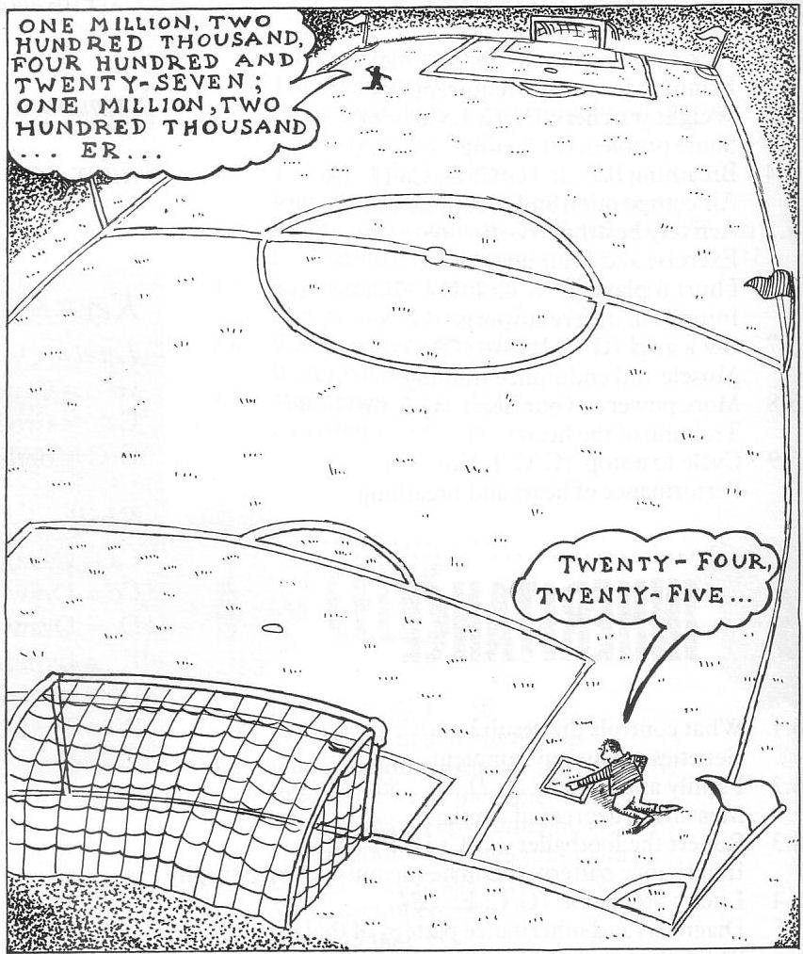
Counting, estimating and sampling

Slide 2
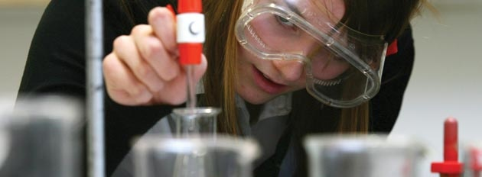
CfE and National 4 and 5
I can sample and identify living things from different habitats to compare their biodiversity and can suggest reasons for their distribution
I understand how animal and plant species depend on each other and how living things are adapted for survival. I can predict the impact of population growth and natural hazards on biodiversity
Give an example of a technique which might be used for sampling organisms, and describe its use
Identify a possible source of error that might accompany a sampling technique and explain how it might be minimised

Slide 3
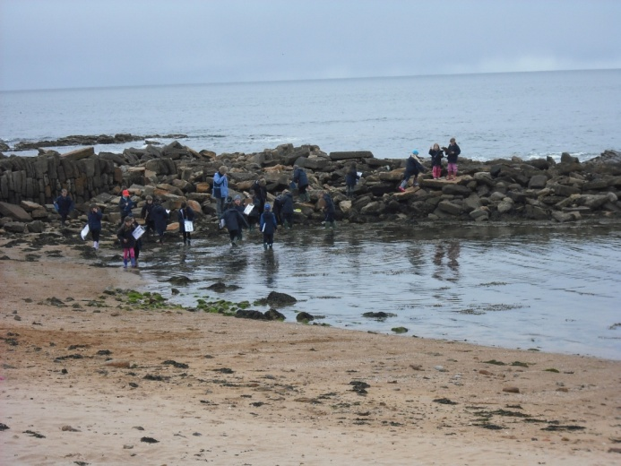
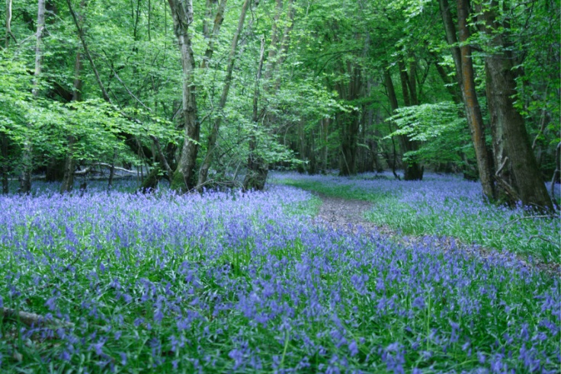
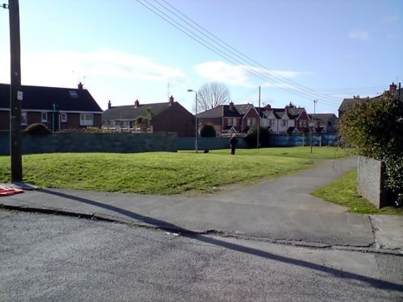
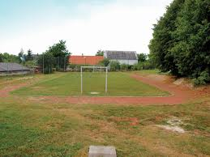
Outdoor Learning

Slide 4
Counting, estimating and sampling
Before we start sampling we should consider a few questions :
  Why do scientists sample?
  What makes a good sample?
  How do scientists sample?
Teaching this topic touches on other important general skills :
  Estimating,
  When you need accuracy and when you do not?
  When does something happen through chance?
  When are other factors effecting a result or a trend?

Slide 5
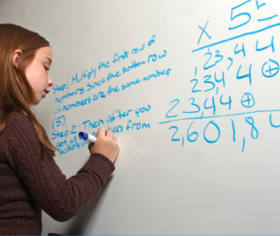
CfE Numeracy
I am developing a sense of size and amount by observing, exploring, using and communicating with others about things in the world around me
I can conduct simple experiments involving chance and communicate my predictions and findings using the vocabulary of probability
When analysing information or collecting data of my own, I can use my understanding of how bias may arise and how sample size can affect precision, to ensure that the data allows for fair conclusions to be drawn
I can round a number using an appropriate degree of accuracy, having taken into account the context of the problem
Having investigated the practical impact of inaccuracy and error, I can use my knowledge of tolerance when choosing the required degree of accuracy to make real-life calculations

Slide 6
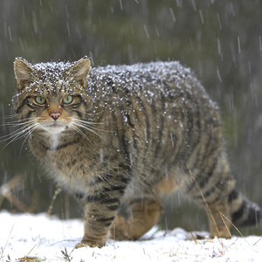
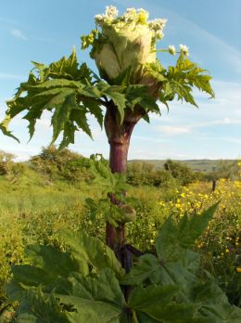
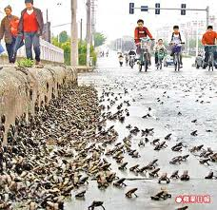
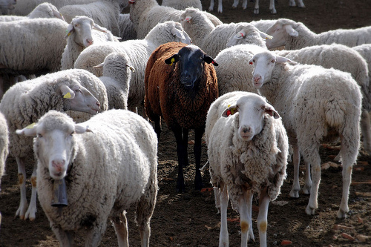
Why do scientists sample?

Slide 7
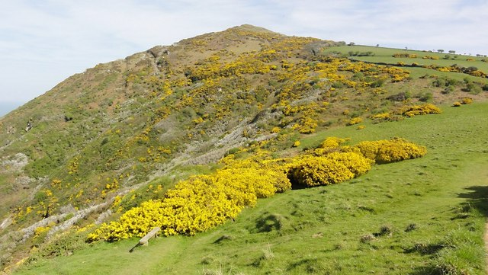
What makes a good sample?

Slide 8
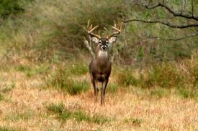
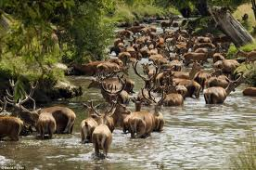
What makes a good sample?
The sample is representative of the whole
You do enough sampling to even out random differences

Slide 9
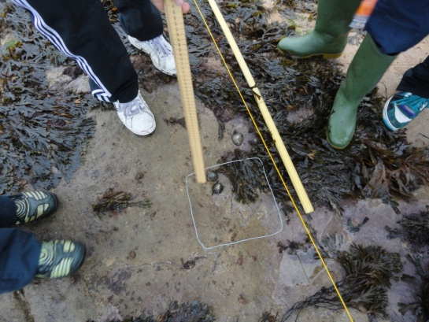
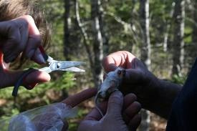
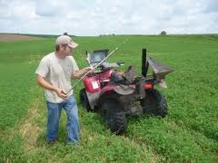
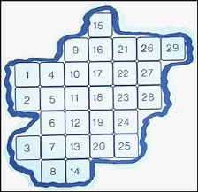
How do scientists sample?
You need a system

Slide 10
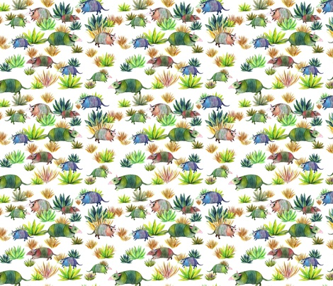
How many armadillos?

Slide 11
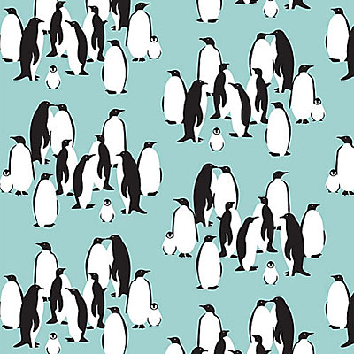
How many penguins?

Slide 12
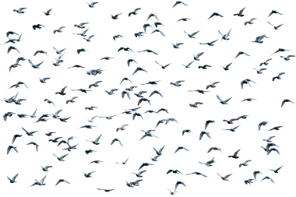
A tricky challenge

Slide 13
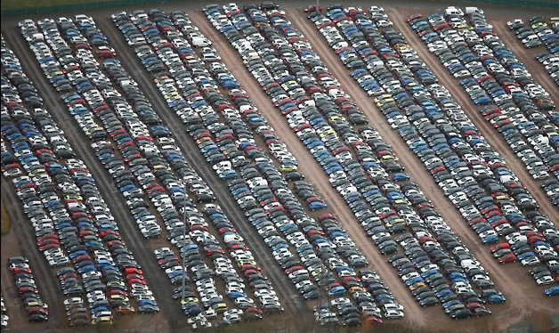

How many cars in the car park?

Slide 14
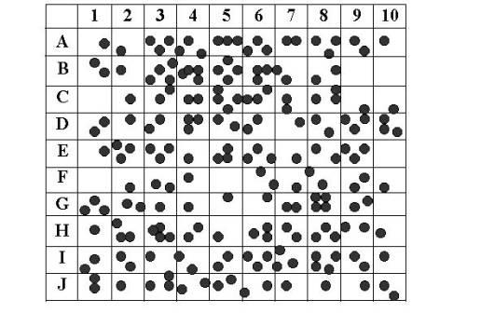

Slide 16
What is happening here?

Slide 17

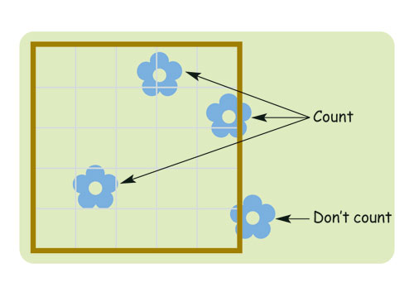
Getting a bit more realistic
Take a piece of material 50cm x 50cm and lay out
on desk. Collect a quadrat 5cm x 5cm
Task
Try to estimate how many flowers or equivalent
are on your piece of material
Before you begin discuss your the system you are
going to use and write it down

Slide 18
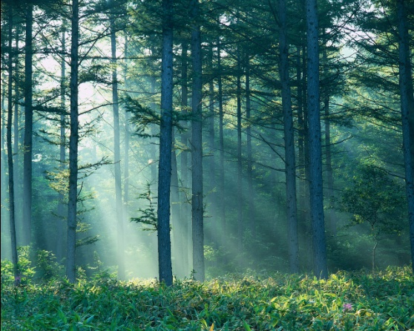
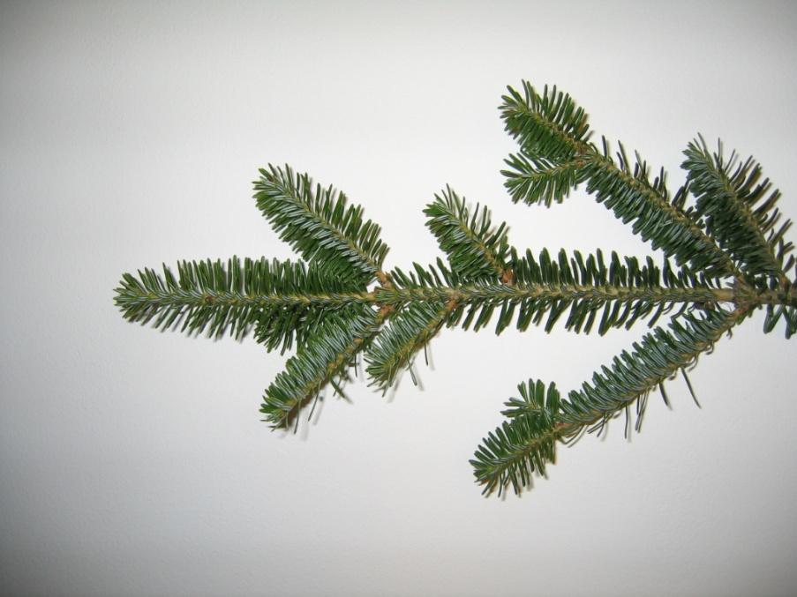
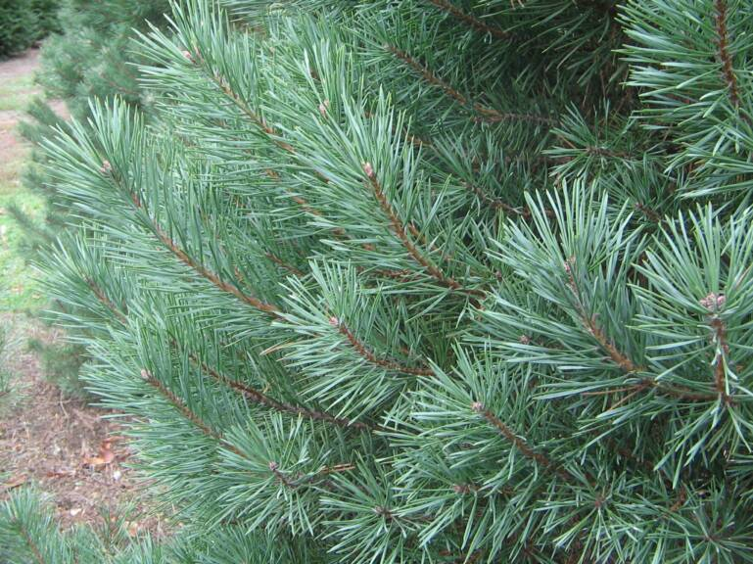
Coniferous Forest

Slide 19
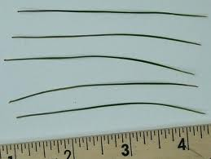
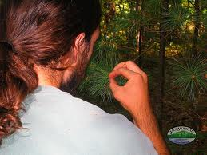
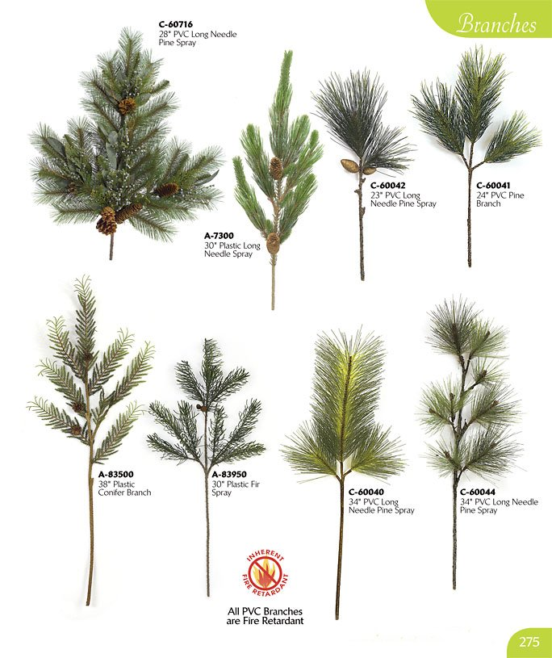
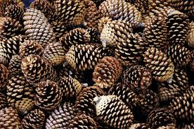

Slide 20
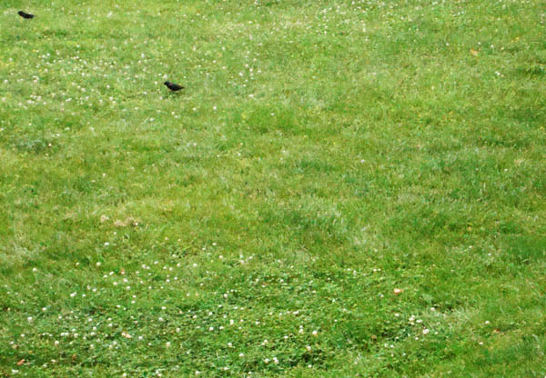
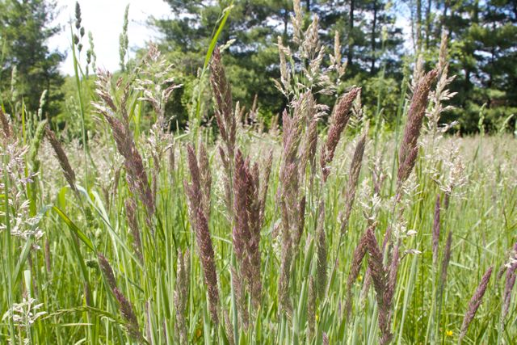
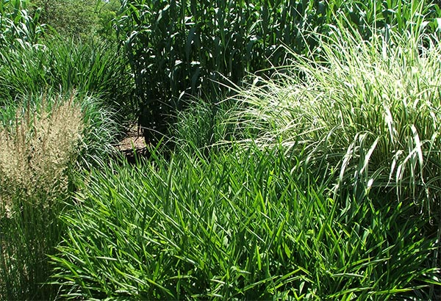
Biodiversity in Grasses

Slide 21
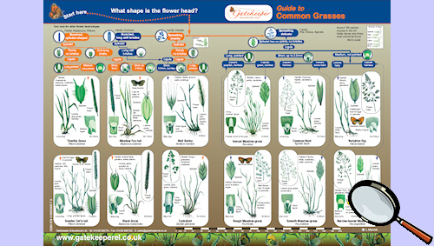

Slide 22
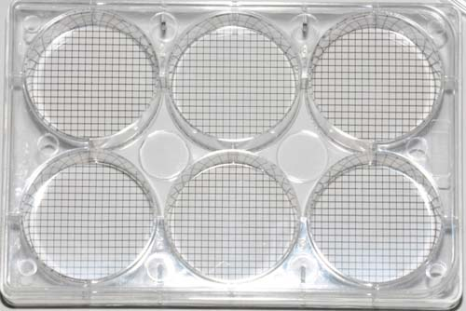
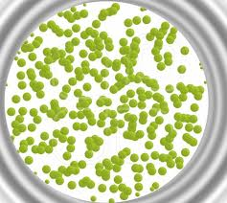
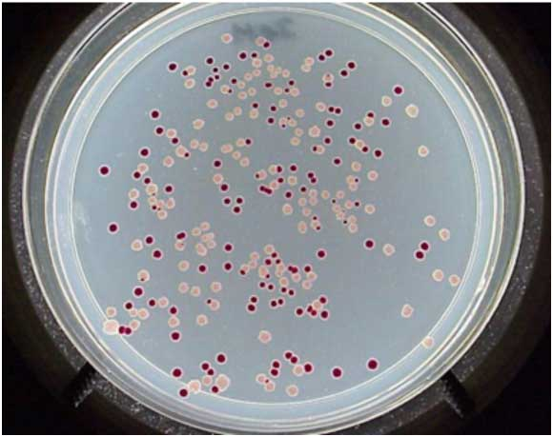
Counting microbes and microbial
biodiversity

Slide 23
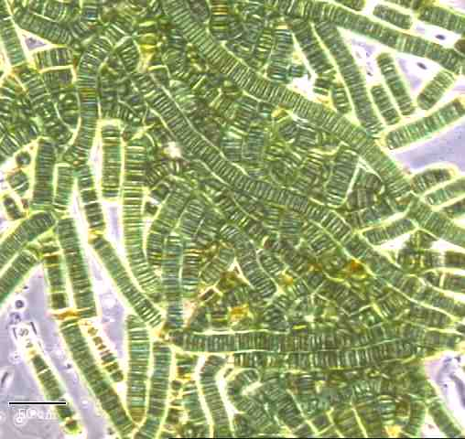
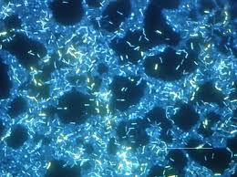
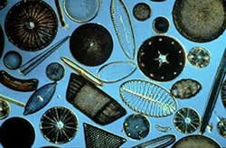
Microbial Biodiversity

Slide 24
CfE and National 4 and 5
I can sample and identify living things from different habitats to compare their biodiversity and can suggest reasons for their distribution
I understand how animal and plant species depend on each other and how living things are adapted for survival. I can predict the impact of population growth and natural hazards on biodiversity
Give an example of a technique which might be used for sampling organisms, and describe its use
Identify a possible source of error that might accompany a sampling technique and explain how it might be minimised

Slide 25
Comments and Feedback
An area for development?

