Slide 1
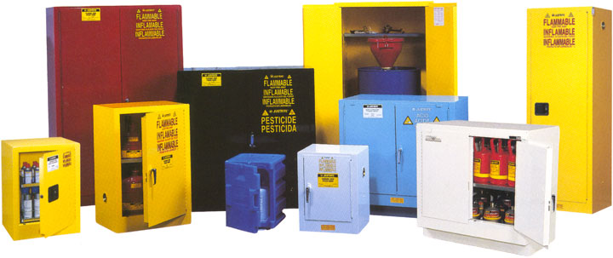
Storing Chemicals

Slide 2
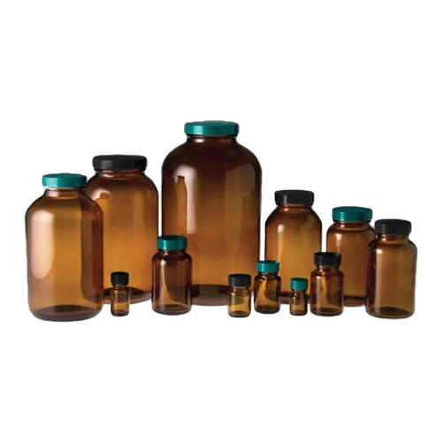
What Should we Store it in?
Use those provided by the manufacturers
Suitable Type
Size
Labelling
Condition
Notes:
Things like jam-jars and drinks bottles are not generally suitable.
If they need to be used, all the original labelling should be removed and placed with clear labelling of what is actually there.
If something is being decanted, put a date on it as well as details of name, concentration, hazards etc.

Slide 3
Where Should we Store it?
In the lab
Small amounts of Low hazard chemicals, Harmful (Ac Tox 4), Irritant can be kept in the laboratory – at least in the short term
Everything else should be in the chemical store (or occasionally in the prep room)
Notes:
Keep lab-stored chemicals to a minimum.
Prep room is fine for low hazard things – dilute acids etc.
Anything of more than a minor hazard should be kept in the chemical store.

Slide 4
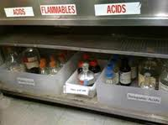
Segregation
The important thing here is to keep Flammables and Oxidisers well away from each other.
Notes:
Organic and inorganic reagents can be kept together or separated as preferred
Oxidising agents should be kept away from organics and alkali metals
Don’t segregate poisons – it just adds one layer of complexity too many.
Corrosives – to a point. Keep conc acids at floor level but eg NaOH can be on shelves with other inorganics.

Slide 5
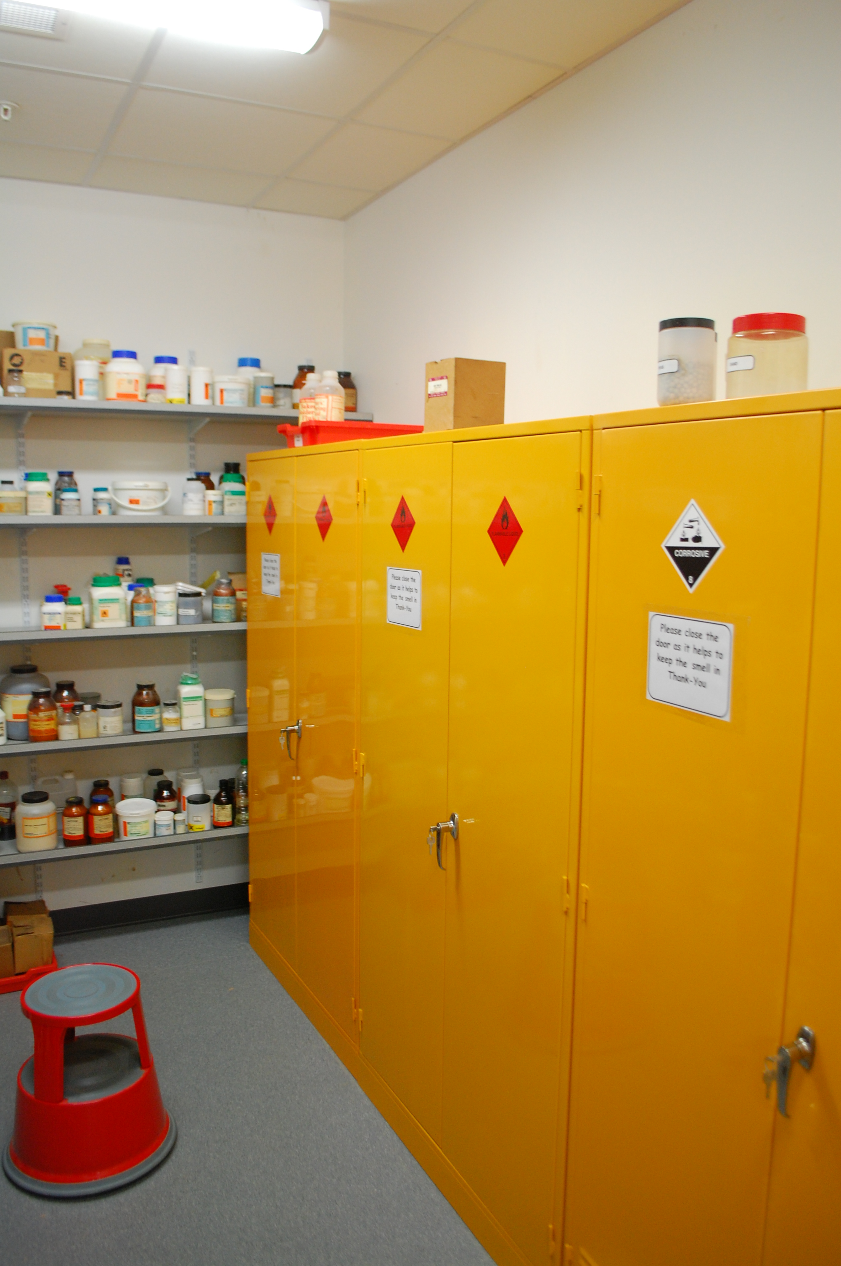
Flammables
Unless you have a dedicated Flammables store, your flammables should be kept in a cabinet, positioned as far from the door as practicable.
If you can’t fit all of them in the cabinet, concentrate on the most flammable.
Notes:
Flammables – particularly Class 1 & 2 should be kept in a flame proof metal cabinet – at the furthest end of chemical store away from the door
Alkali metals should be kept in a separate box
Corrosives cabinets tend to corrode (surprise) and are not needed.
No need for a poisons cabinet – can interfere with segregation which is more important
There is no actual problem with cabinets but they tend to take up a lot of room.

Slide 6
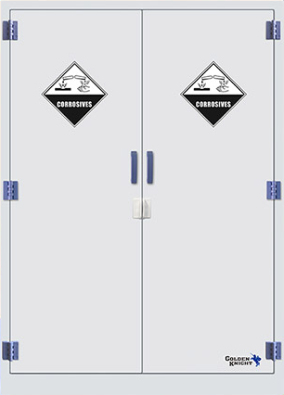
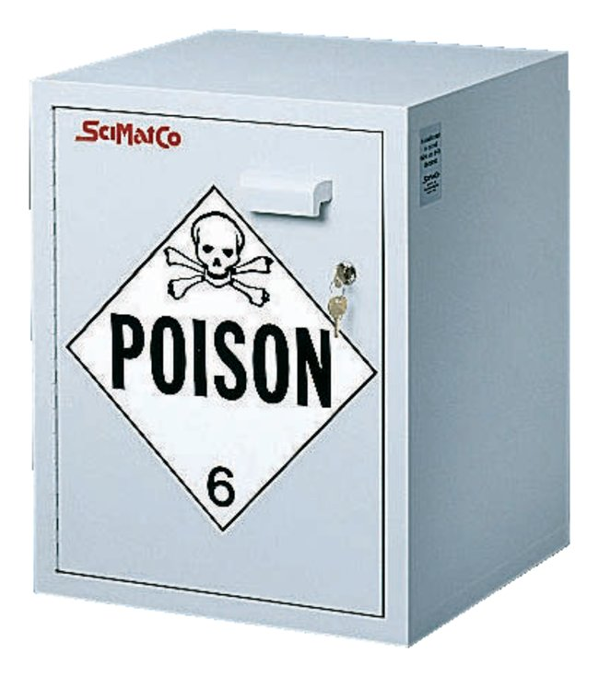
Other cabinets
Corrosives? No need – they will just corrode! But not a problem.
Poisons? Not a good idea – can cause problems with other segregation

Slide 7
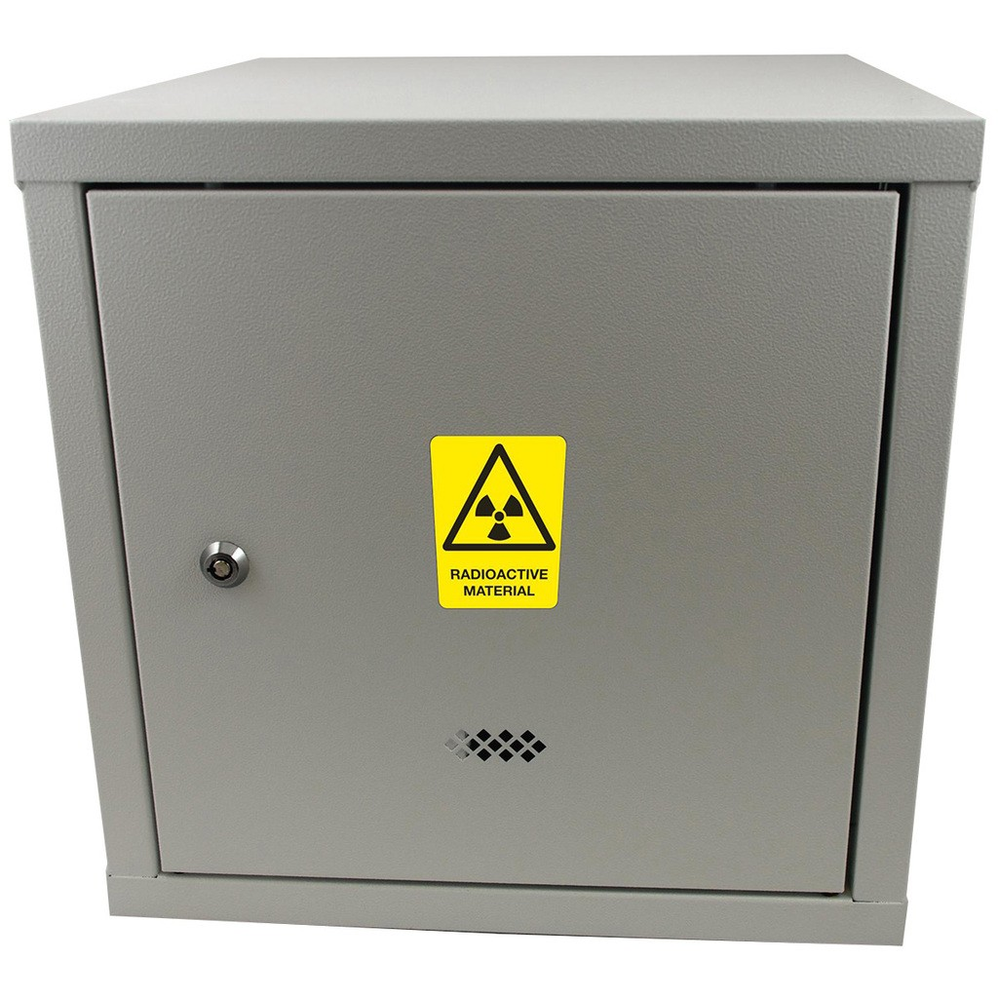
Other cabinets
Radioactives? Yes – in a specialised cabinet suitably positioned.
Water reactives (mainly alkali metals) – No specific cabinet but in either a small cabinet or a tin/box to keep water out.

Slide 8
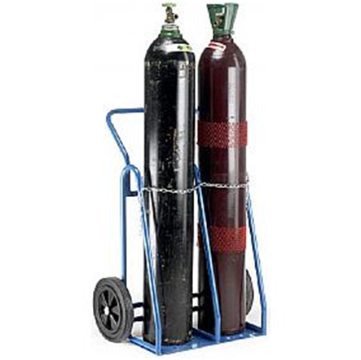
Gas Cylinders
Not in the chemical store.
In the prep room, against a wall, fixed firmly so they can’t fall over.
Keep H₂ and O₂ apart.
Notes:
Not in the chemical store.
Prep room is OK. Fixed to the wall, ideally an outside one.
Hydrogen and oxygen cylinders should not be kept close to each other.
The regulators need to be professionally serviced every 5 years.

Slide 9
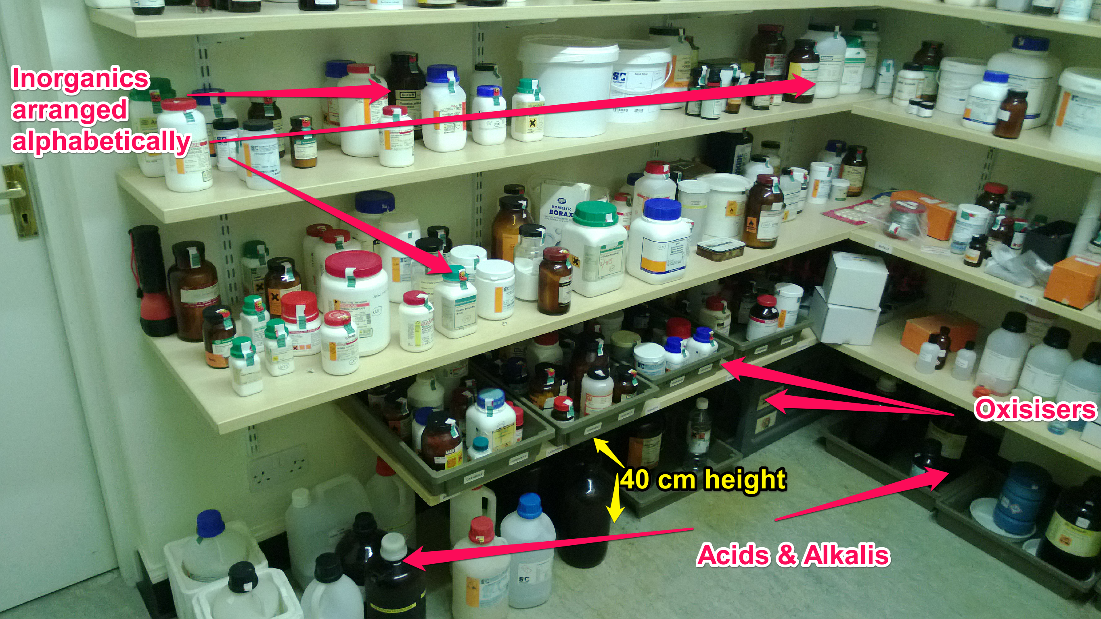
Shelving?
Separation
Lips
Height
Notes:
If you want lips on the shelves, that is entirely up to you. Chemicals tend not to leap to their doom
Keep oxidisers away from, particularly, organics and flammables.
Acids/alkalis can be stored at floor level on the open lab.
Remember things like H₂SO₄ to be kept away from HCl

Slide 10
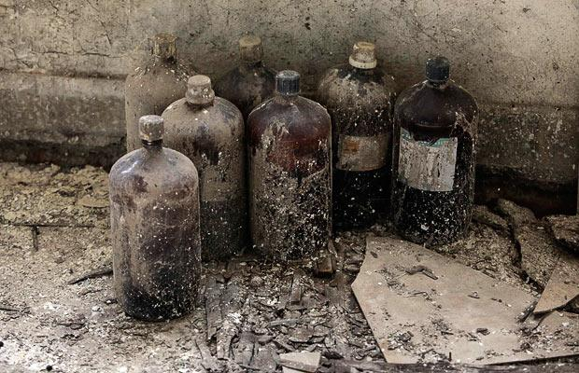
How long Should we Store it for?
SSERC Safe Shelf Life List
Eg potassium
SSERC Shelf life list
Eg ammonia
Expiry Dates
Notes:
Safe shelf life – storage for longer can be hazardous – stick to the guidelines
Shelf life – storage for longer is not hazardous but the concentration/effectiveness can decrease. Use until it isn’t working.
Others – no reason to dispose of a chemical you might use if it is still OK.
If a chemical has been prepared in the school, it is important to put a date on it
Manufacturers put a use by date on their chemicals. This is rather like the best before date on food. It will almost certainly be absolutely fine after that date but they will not guarantee its quality. (Sigma – “This date assigns the time frame during which the batch is expected to remain within established specifications if stored under Sigma-Aldrich’s defined conditions. ”)

Slide 11
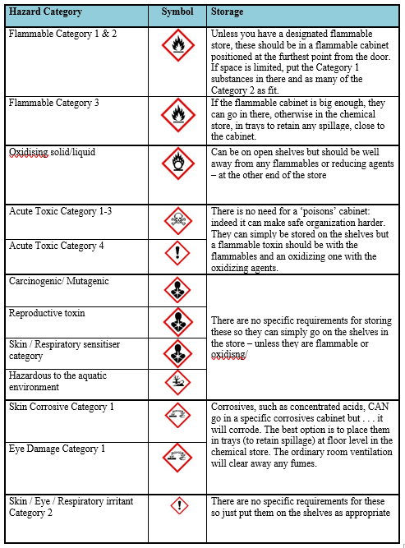
Category by category guidance

