Slide 1
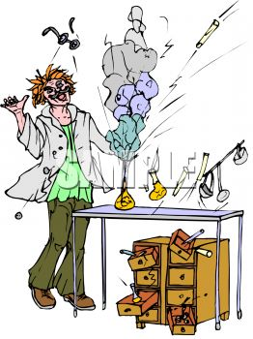
Chemical
Spills

Slide 2
Rule 1 – Don’t spill anything
Rule 2 – If you must – spill as little as possible
Notes:
I know it sounds obvious but there are things you can do:
Make sure the likelihood of spillage is minimised.
Ensure there are no trip/slip hazards where anyone might be carrying chemicals
Make sure chemicals are placed securely on shelves/benches, not too close to the edge, and in stable containers.
Ensure minimum quantities of hazardous chemicals can be spilled
Have the technician decant say 25cm3 of concentrated acids rather than bring out a winchester full.
Similarly a few g of magnesium powder rather than the whole jar.

Slide 3

When to deal with spills
Notes:
There are some spillages that you should simply leave to the experts.
Basically, any spill that generates large amounts of hazardous fumes. In particular:
Bromine
.880 Ammonia
Glacial ethanoic acid (and propanoic or butanoic acids)
Concentrated hydrochloric acid
Concentrated nitric acid
And any other source of hazardous fumes – if for instance the spillage is a dilute acid and a sulphite – it will generate sulphur dioxide.
In situations like this, evacuate the chemicals store/prep room/classroom as soon as possible – There MAY be time in the larger space of a classroom to open a window or switch on a ducted fume cupboard in passing.
In most cases, the ventilation will run its course and clear the air – though it could take many hours.
If the ventilation is not clearing it – call the fire brigade.

Slide 4
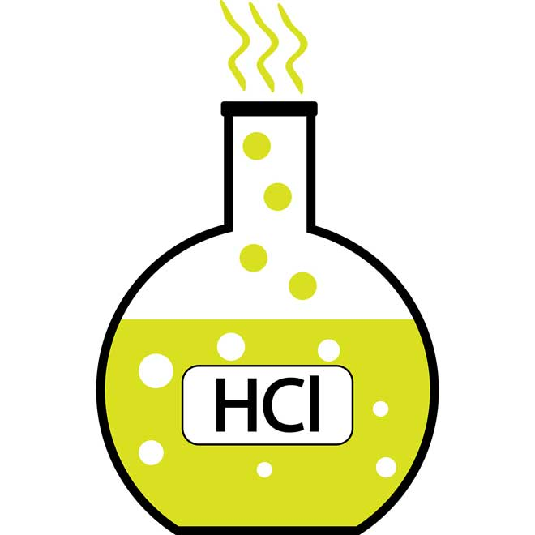
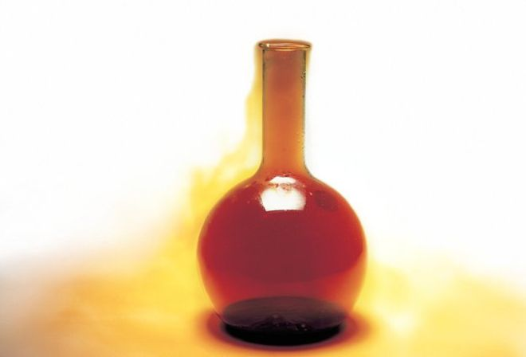
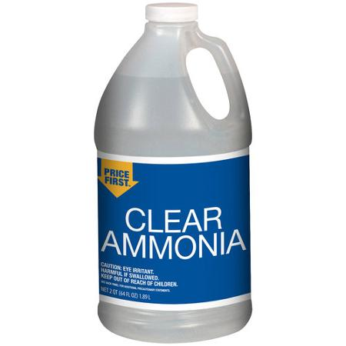
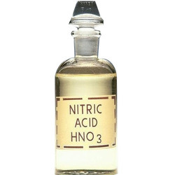
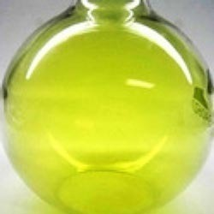
When to deal with spills
Notes:
Remember to look after your own safety.
In the case of significant spills of substances releasing toxic fumes (eg Bromine, chlorine, HCl, ammonia etc) just evacuate the room, close the door and let the ventilation clear it.

Slide 5
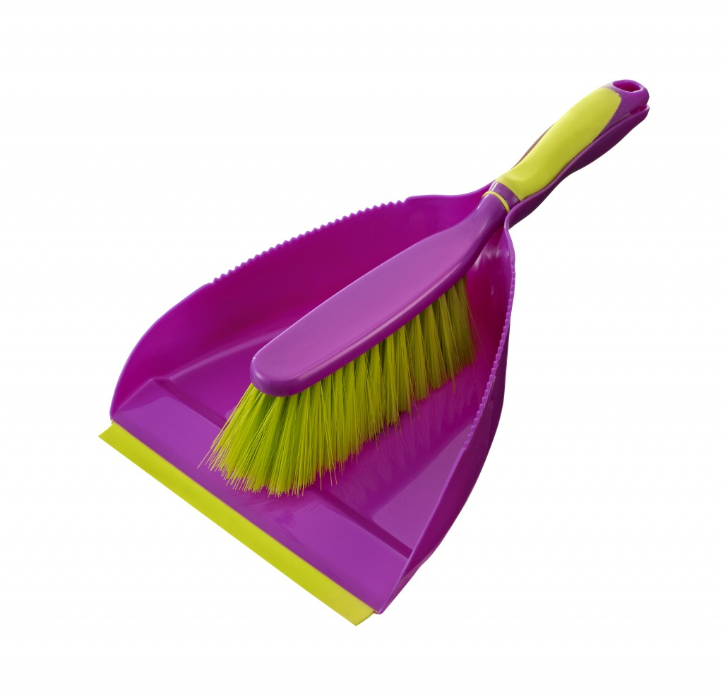
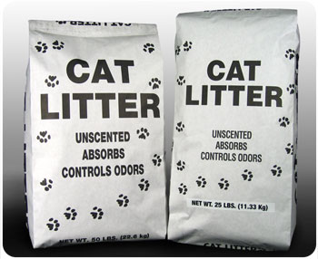
Powders & Liquids
Notes:
In general, solids are pretty easy to deal with:
Collect them up in a dustpan and brush and dispose as recommended for that chemical.
Be wary of powders – avoid raising dust - if this can’t be avoided, wear a well-fitting dust mask.
Liquids can be absorbed into a solid – cat litter is the best for this. It can then be swept up and disposed of. It can then either be disposed of in the normal waste – washed with water to get rid of the chemical or, if it is toxic etc, bagged, sealed in a container, labelled and kept for uplift.
If the liquid is an acid or alkali then you need to behave differently.

Slide 6

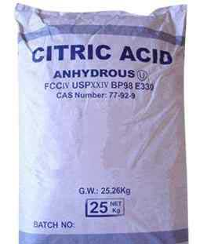
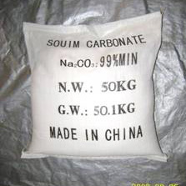
Acids & alkalis
Notes:
Assuming there is no problem with fumes.
For spills of acids – such as concentrated H2SO4 – neutralise with anhydrous sodium carbonate or hydrogencarbonate and then dispose normally
For alkalis – such as sodium hydroxide – if a solid, just brush with a dustpan and brush and dispose normally. If a solution, neutralise with citric acid and then scrape up and dispose.

Slide 7
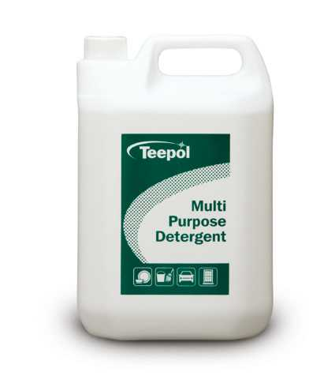
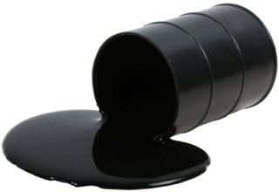
Oils etc.
Notes:
Absorb into cat-litter and clear up as before.
Use detergent to clear up the remnants and make sure the area is safe.

Slide 8
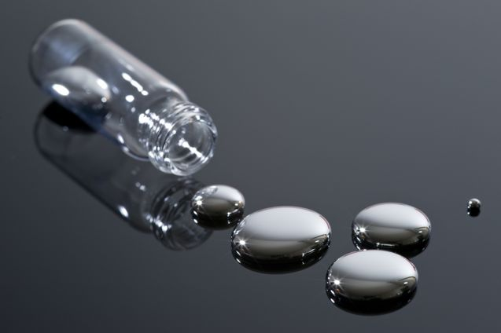
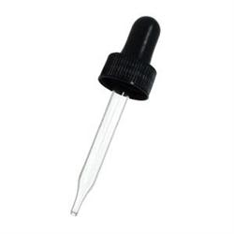
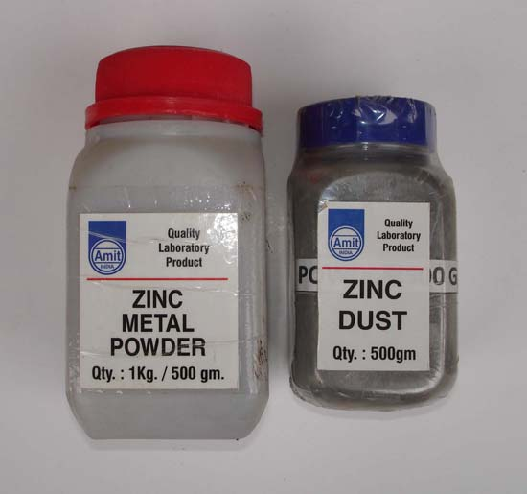
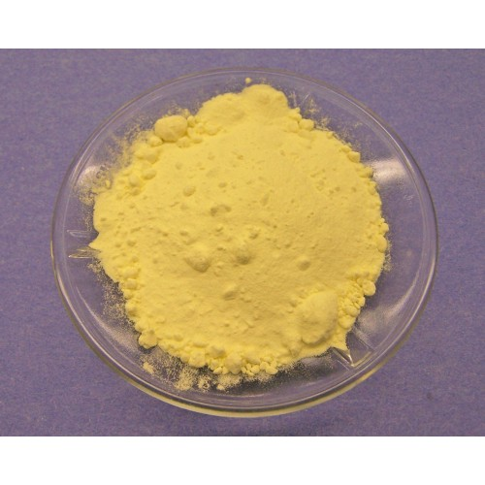
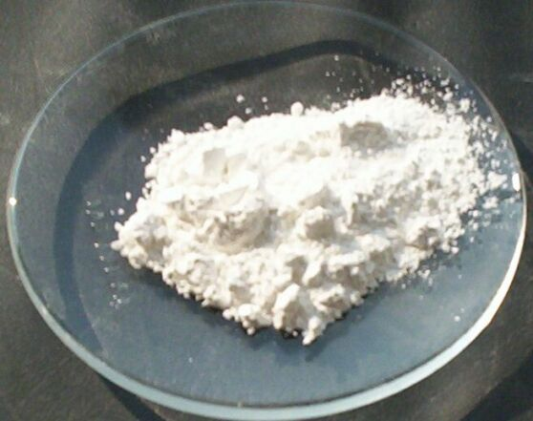
Mercury
Notes:
Zinc powder used to be used for this but the best method now is:
Use a syringe to collect up any drops that can be collected – empty them into a designated bottle.
For the remainder, make a paste of a 50:50 lime/sulphur mix with hot water to make a smooth slurry.
Spread this over the area and leave to dry. Then sweep up. If mercury has got into cracks in floorboards for instance, you can just put the dry s/Ca(OH)2 mix onto it.
When dry, sweep up – a paint brush is best for this – and put the residue in a container for disposal.
Dust the area with dry lime/sulphur mix and if any mercury has got into cracks in woodwork etc, brush the mixture into these cracks.

Slide 9
