Slide 1
Weighing and Measuring

Slide 2
Candidates are required to demonstrate by two practical activities that they are able to:
select, set up and accurately use an appropriate instrument to measure volume
select, set up and accurately use an appropriate instrument to measure mass

Slide 3
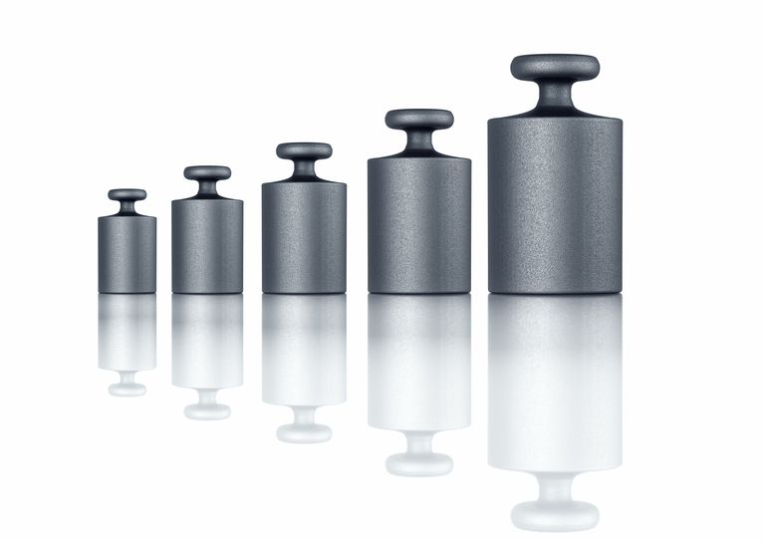
Mass

Slide 4
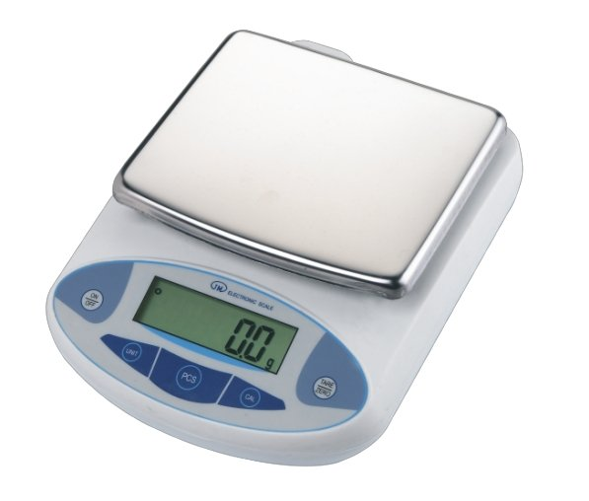
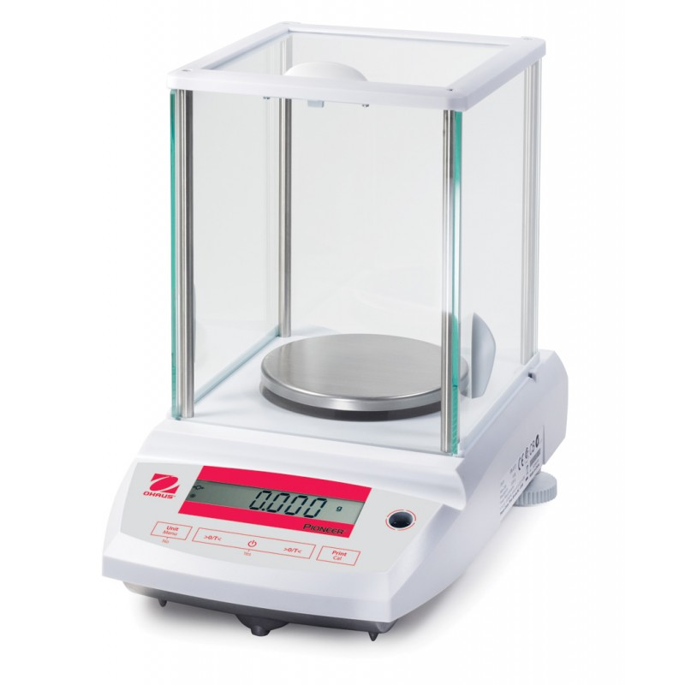
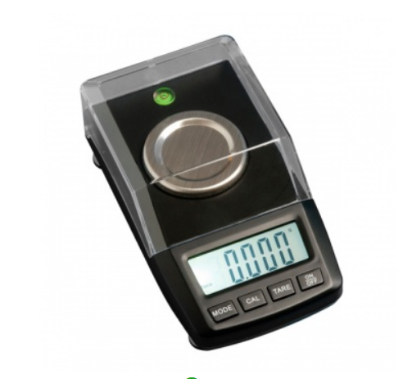
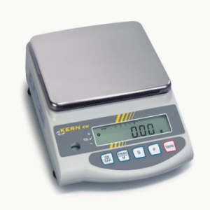
Which Balance?
Notes:
For normal usage, a balance that reads to 2dp (0.01g) is ideal. For many lab solutions, 1 dp (0.1g) would be acceptable but there is not a great amount of saving in either money or time to be gained from using this rather than 2 dp so that is what we would recommend
For accurate work, preparing accurate solutions for some Advanced Higher work for instance, you may need to use a balance that will read to 3 dp (0.001g) or even more.
Be aware of the maximum load a balance can take. Putting too heavy a load on a balance can cause permanent damage to it.

Slide 5
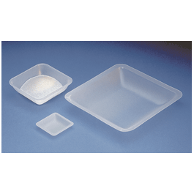
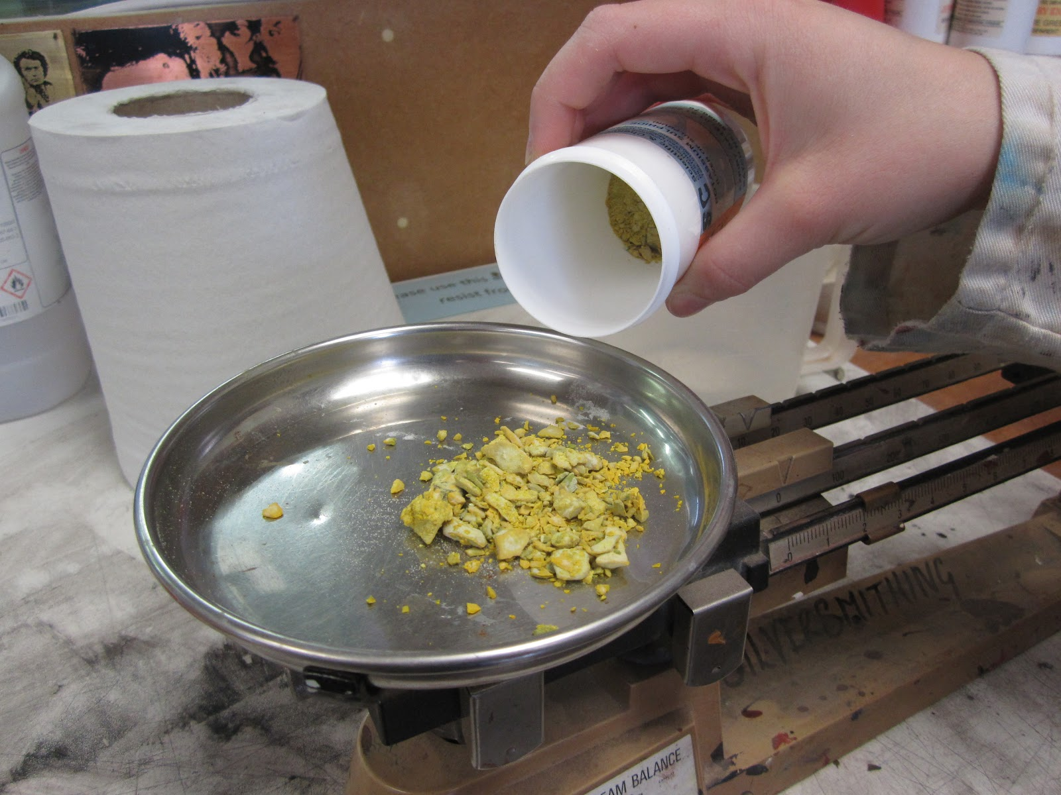
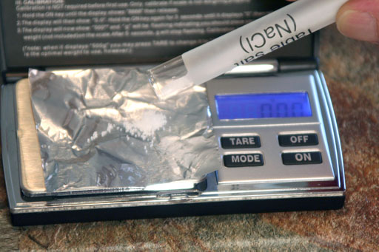
What in?
Notes:
You can buy plastic weigh boats cheaply but at a pinch, either folded aluminium foil or fairy-cake papers made from greaseproof paper will work perfectly well.

Slide 6
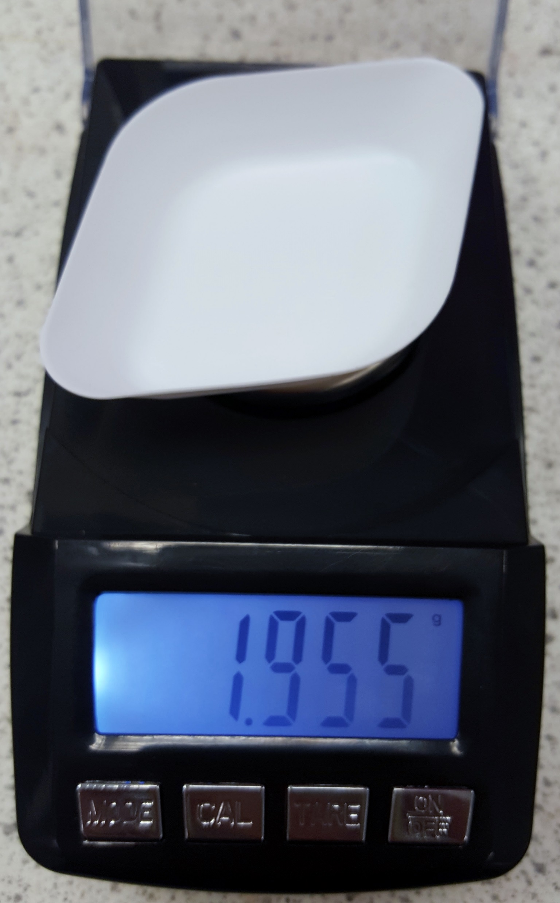
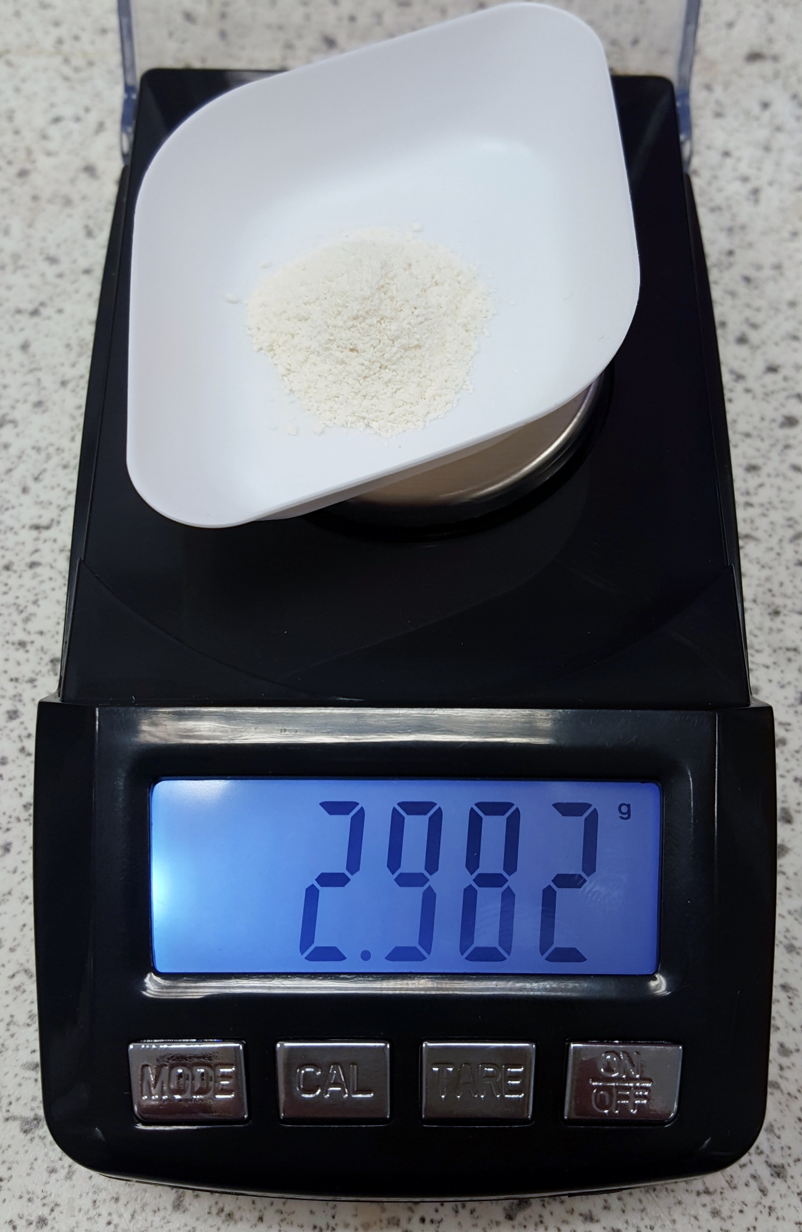
Weighing by difference
2.982 – 1.955 = 1.030g
Notes:
With modern electronic balances at normal levels of accuracy, simply zeroing and taking the reading is perfectly accurate. However, for very accurate work (3/4 dp or more) it is apparently helpful to weigh by difference.
It IS still important if you are following a reaction, eg heating magnesium ribbon.

Slide 7
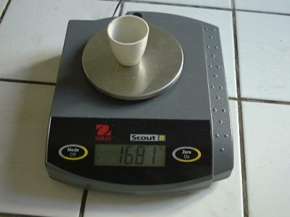
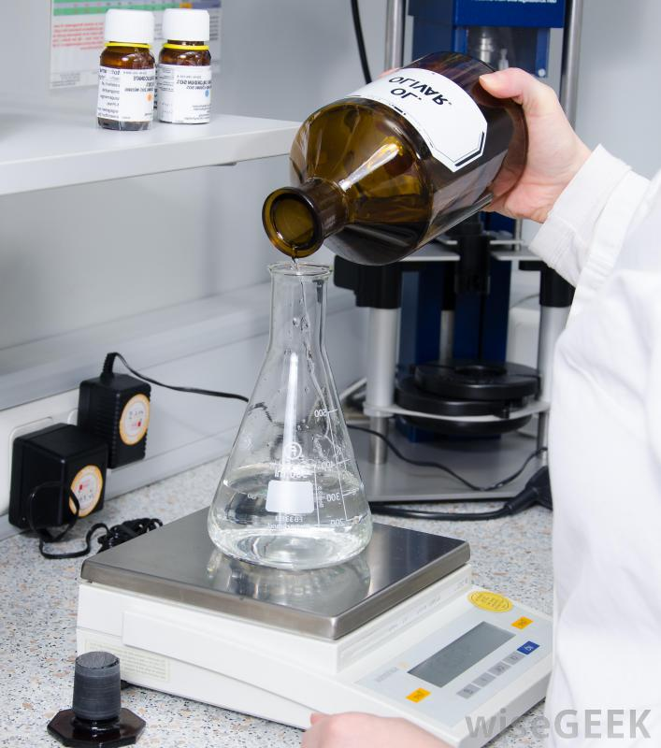
Care of your balance
Notes:
Keep it clean – especially keep liquids off it.
And don’t put hot things on the pan.

Slide 8
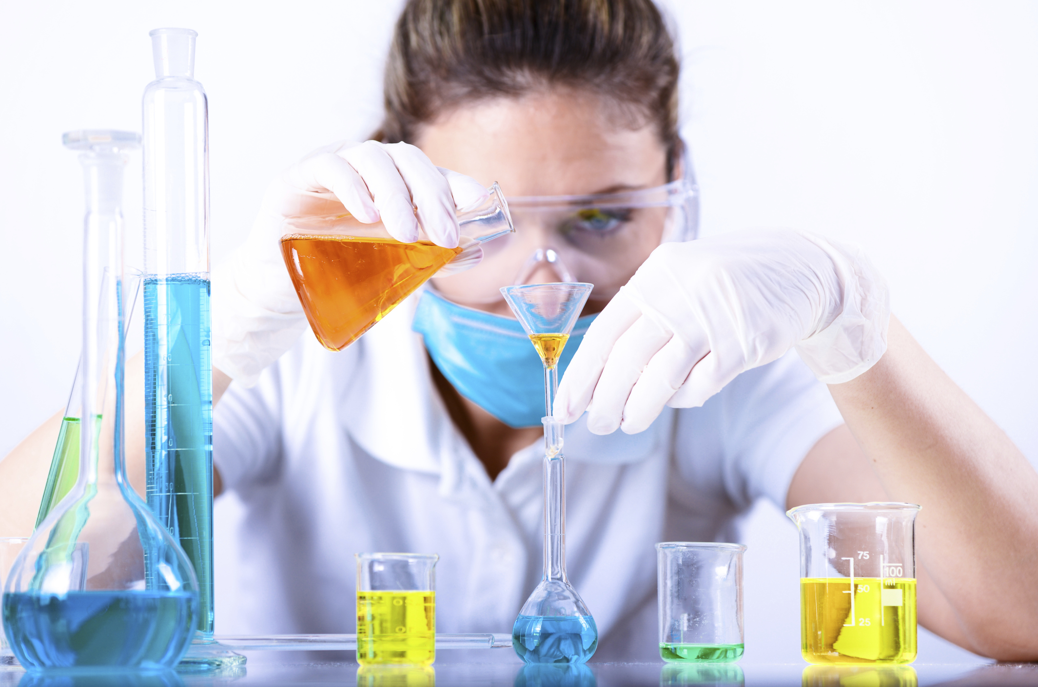
Volume

Slide 9
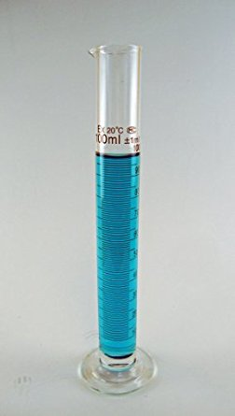
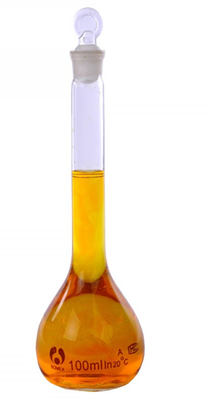
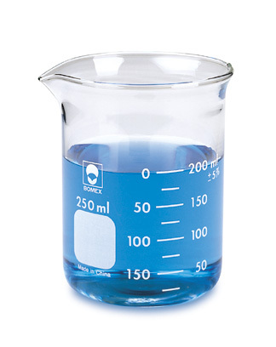
Notes:
Beaker – fine for approximate values
Measuring cylinder – for most work
Volumetric flask – for accurate work

Slide 10
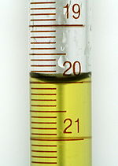
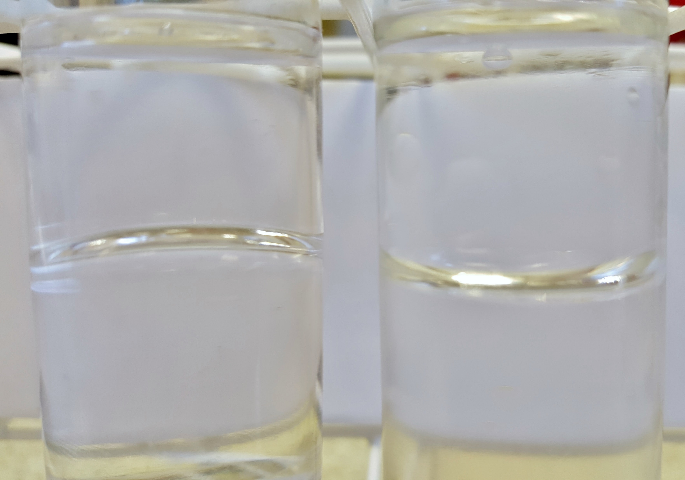
Meniscus
Notes:
The meniscus almost always has a dip in the middle but you can occasionally se a bulge, depending on the liquid and container combination.

Slide 11
Making up a solution
Weigh out your chemical
Roughly measure 2/3 -3/4 of your final volume of solvent
Add chemical and stir until dissolved
Add solvent up to required volume

Slide 12
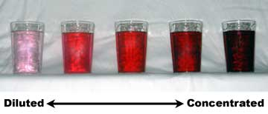
Concentration
Molarity (mol l⁻¹)
% m/v
% v/v
Notes:
1 molar = 1 gramme formula mass per litre
% m/v = 2% = 2g per 100cm3
% v/v = 2% = 2 cm3 per 100 cm3

Slide 13
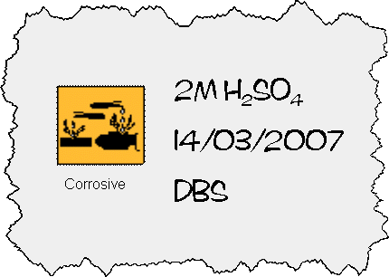
Labelling bottles
Labels on school reagents
Notes:
The new labelling regime is only mandatory for suppliers. However, our recommendation is that schools and colleges switch to the new labelling system.
You are required under COSHH to communicate any chemical hazards
As well as the hazard symbol you should also include:
The name (better than formula) in case the person lacks chemical experience)
The concentration
The date it was made up
The initials of who made it (optional)

