Slide 1
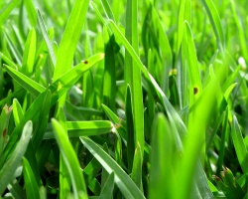
I am grass. I am eaten by a rabbit

Slide 2
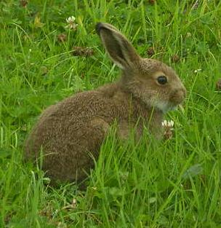
I am a rabbit. I am eaten by a fox.

Slide 7
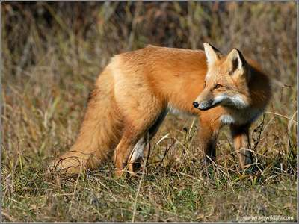
I am a fox.

Slide 8
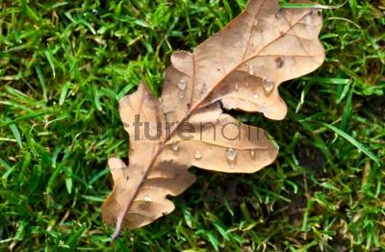
I am an oak leaf. I am eaten by an earthworm.

Slide 9
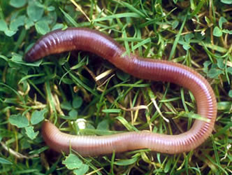
I am an earthworm. I am eaten by a shrew.

Slide 10
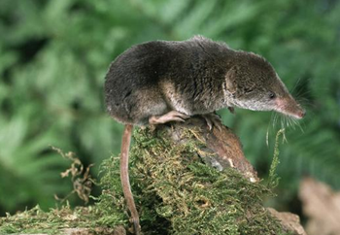
I am a shrew. I am eaten by an owl.

Slide 11
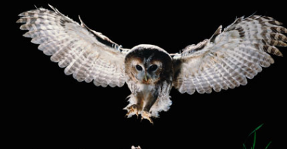
I am an owl.

Slide 12
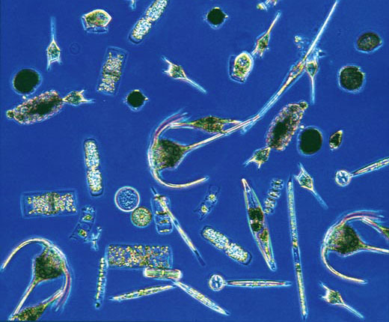
I am plant plankton. I am eaten by Arctic cod.

Slide 13
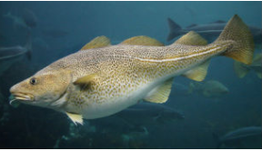
I am an Arctic cod. I am eaten by a seal.

Slide 14
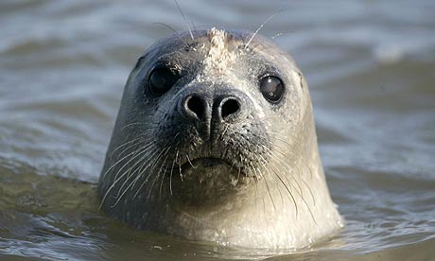
I am a seal. I am eaten by a polar bear.

Slide 15
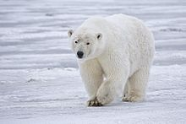
I am a polar bear.

Slide 16
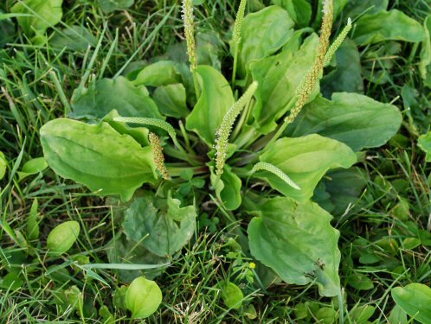
I am a green plant. I am eaten by a mouse.

Slide 17
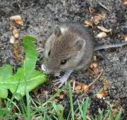
I am a mouse. I am eaten by a rattle snake.

Slide 18
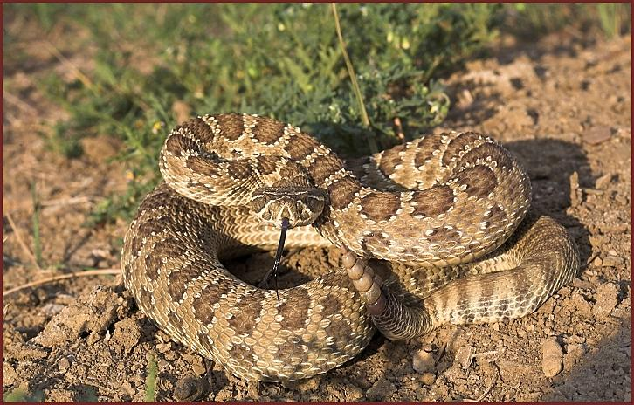
I am a rattle snake. I am eaten by a hawk.

Slide 19
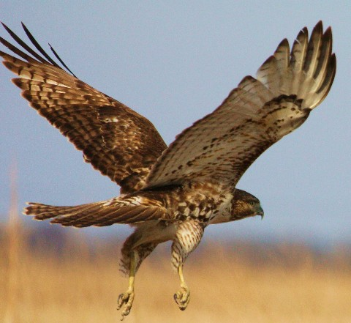
I am a hawk

Slide 20


