Slide 1
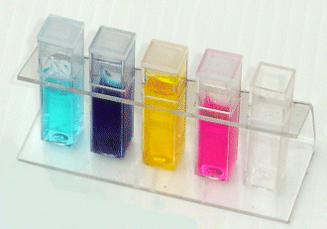
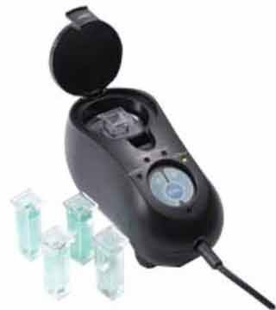
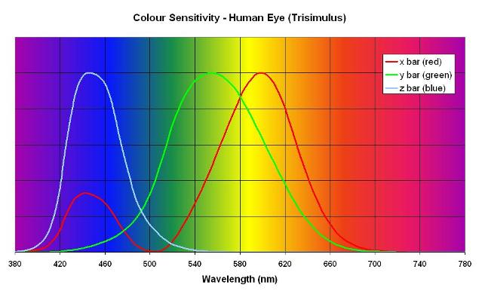
Build your own colorimeter

Slide 2
What is Colorimetry
"the measurement of colour"
"any technique used to evaluate an unknown colour in reference to known colours".

Slide 3
What is a colorimeter?
An apparatus that allows the absorbance of a solution at a particular frequency (colour) of visual light to be determined.
Colorimeters hence make it possible to ascertain the concentration of a known solute, since it is proportional to the absorbance.

Slide 4
The Beer-Lambert Law
The Beer-Lambert law (or Beer's law) is the linear relationship between absorbance and concentration of an absorbing species.

Slide 5
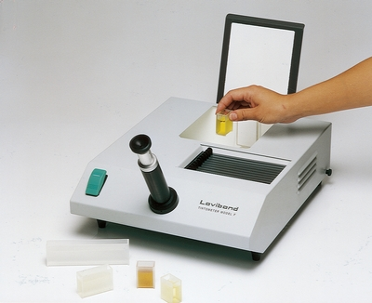
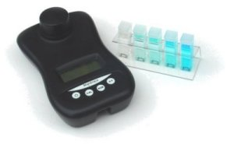
Current Colorimeters
£3,644 + VAT!
£109 + VAT!

Slide 6
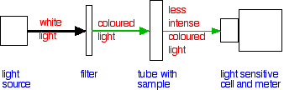
How do they work?

Slide 7
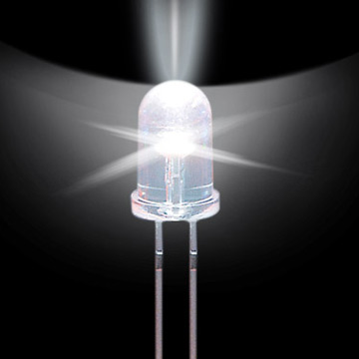
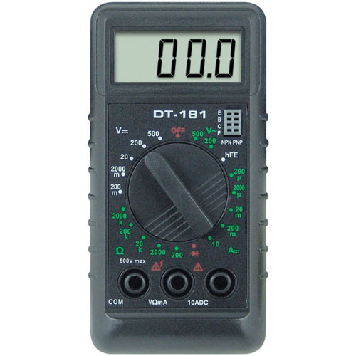
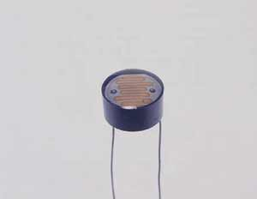
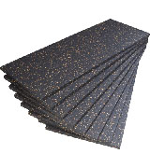
So what do you need?
A light source
A way of measuring the light
A light detector
Something to hold it all

Slide 8
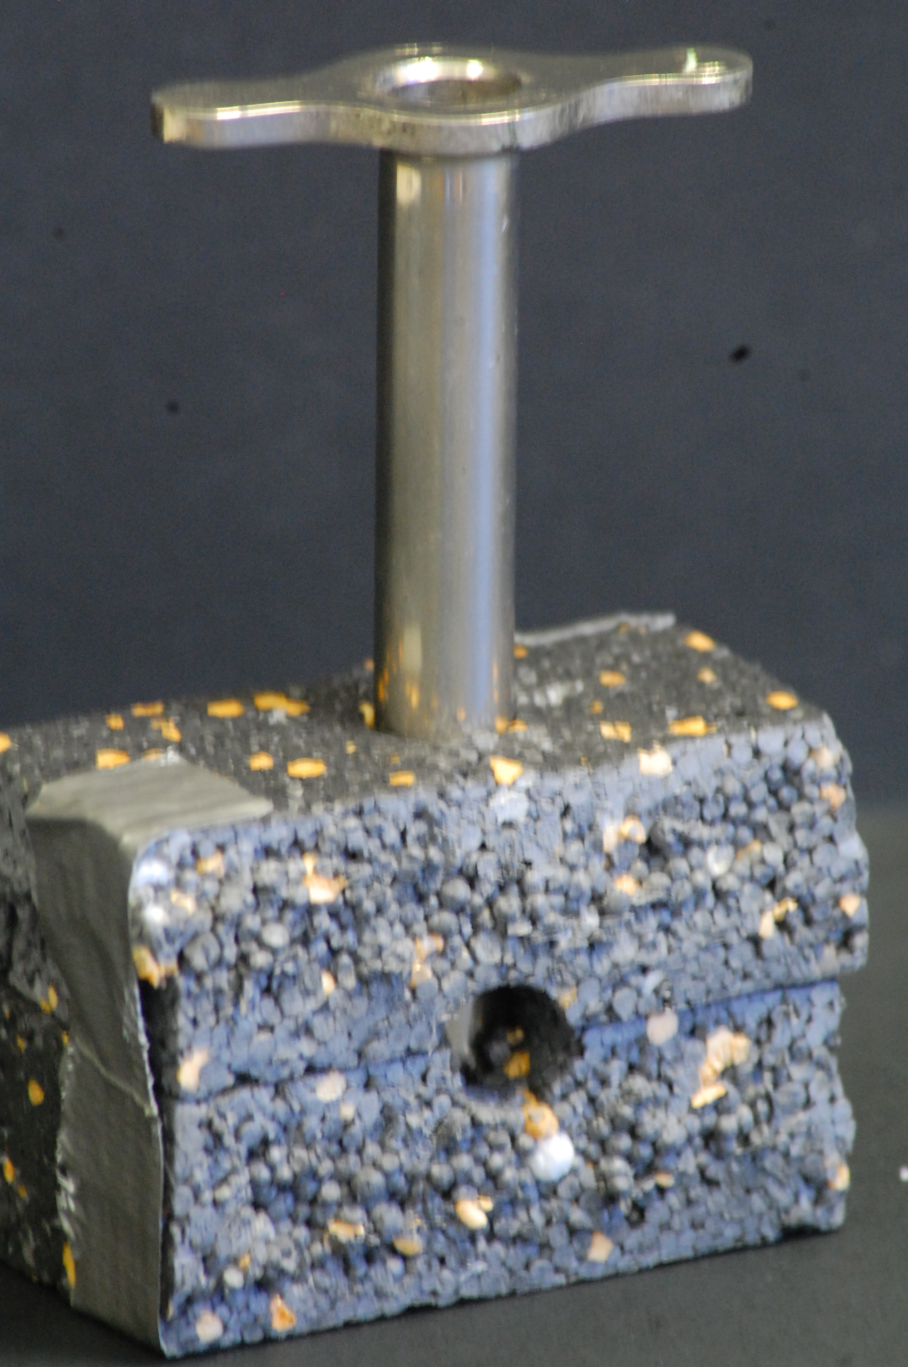
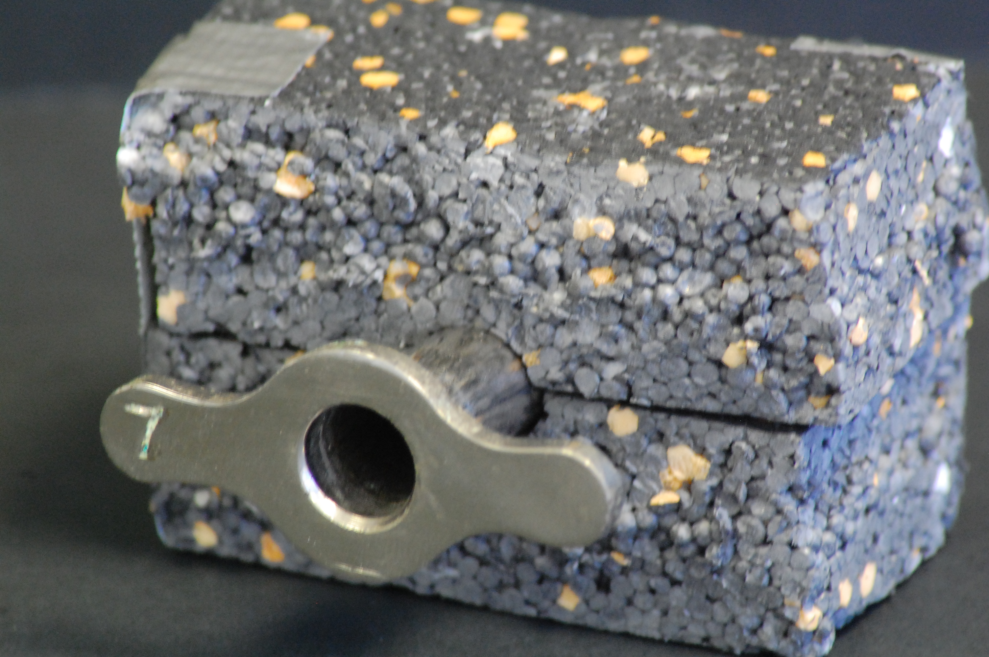
How do you put it together?
Use a cork borer to make holes

Slide 9
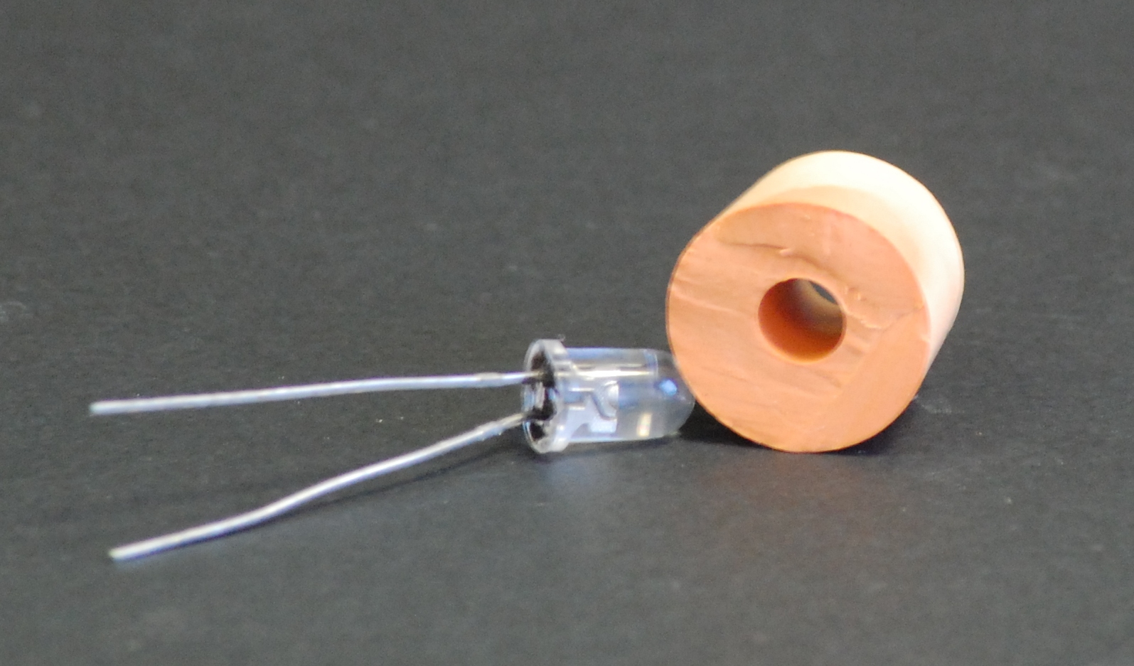
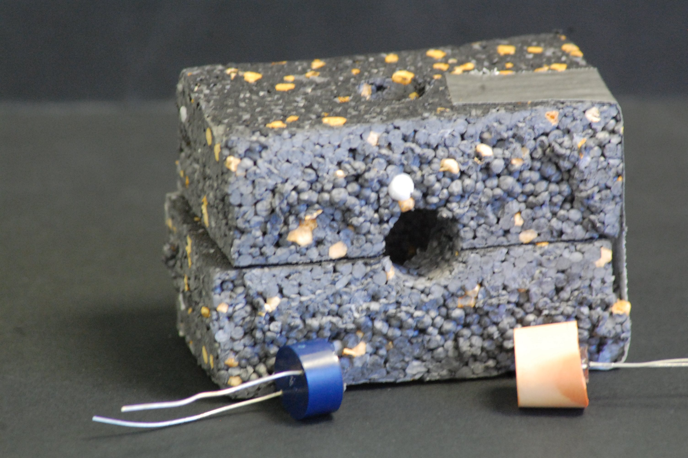
How do you put it together?
Push the LED into a cut-down bung and push it into one end of the hole
Push the LDR the other end of the hole

Slide 10
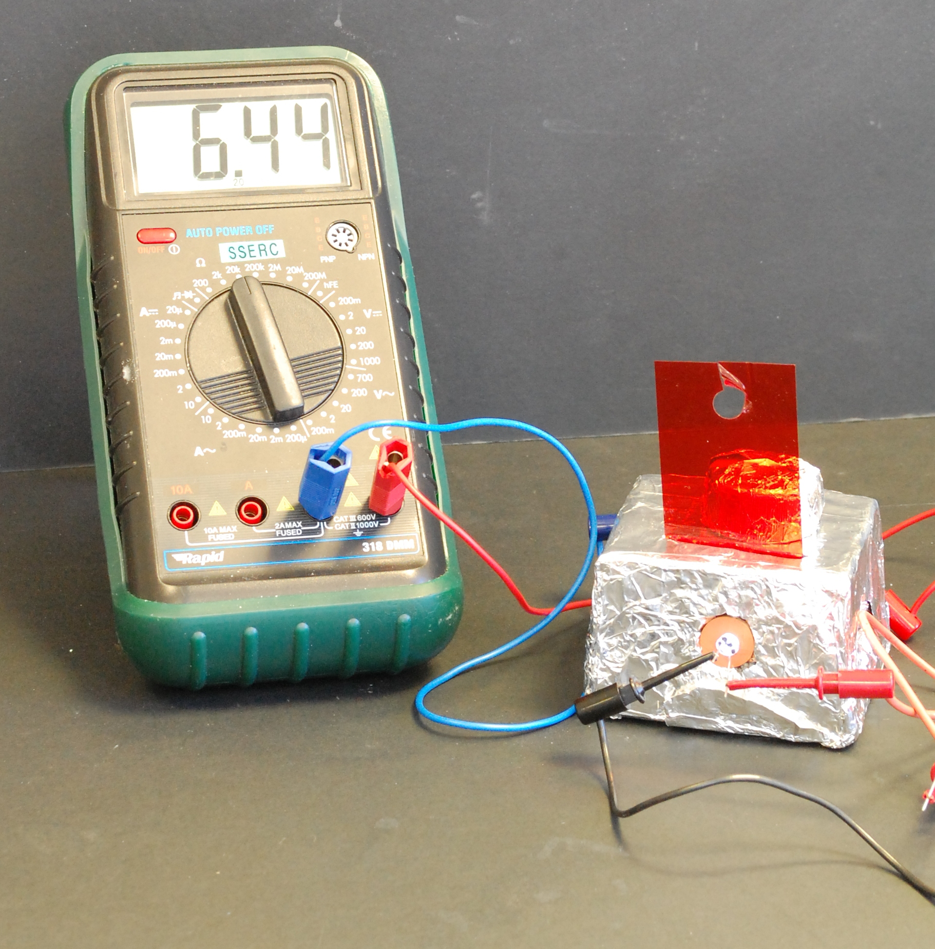
How do you put it together?
Connect the LED to a power supply
Connect the LDR to a multimeter and set it to measure resistance.

Slide 11
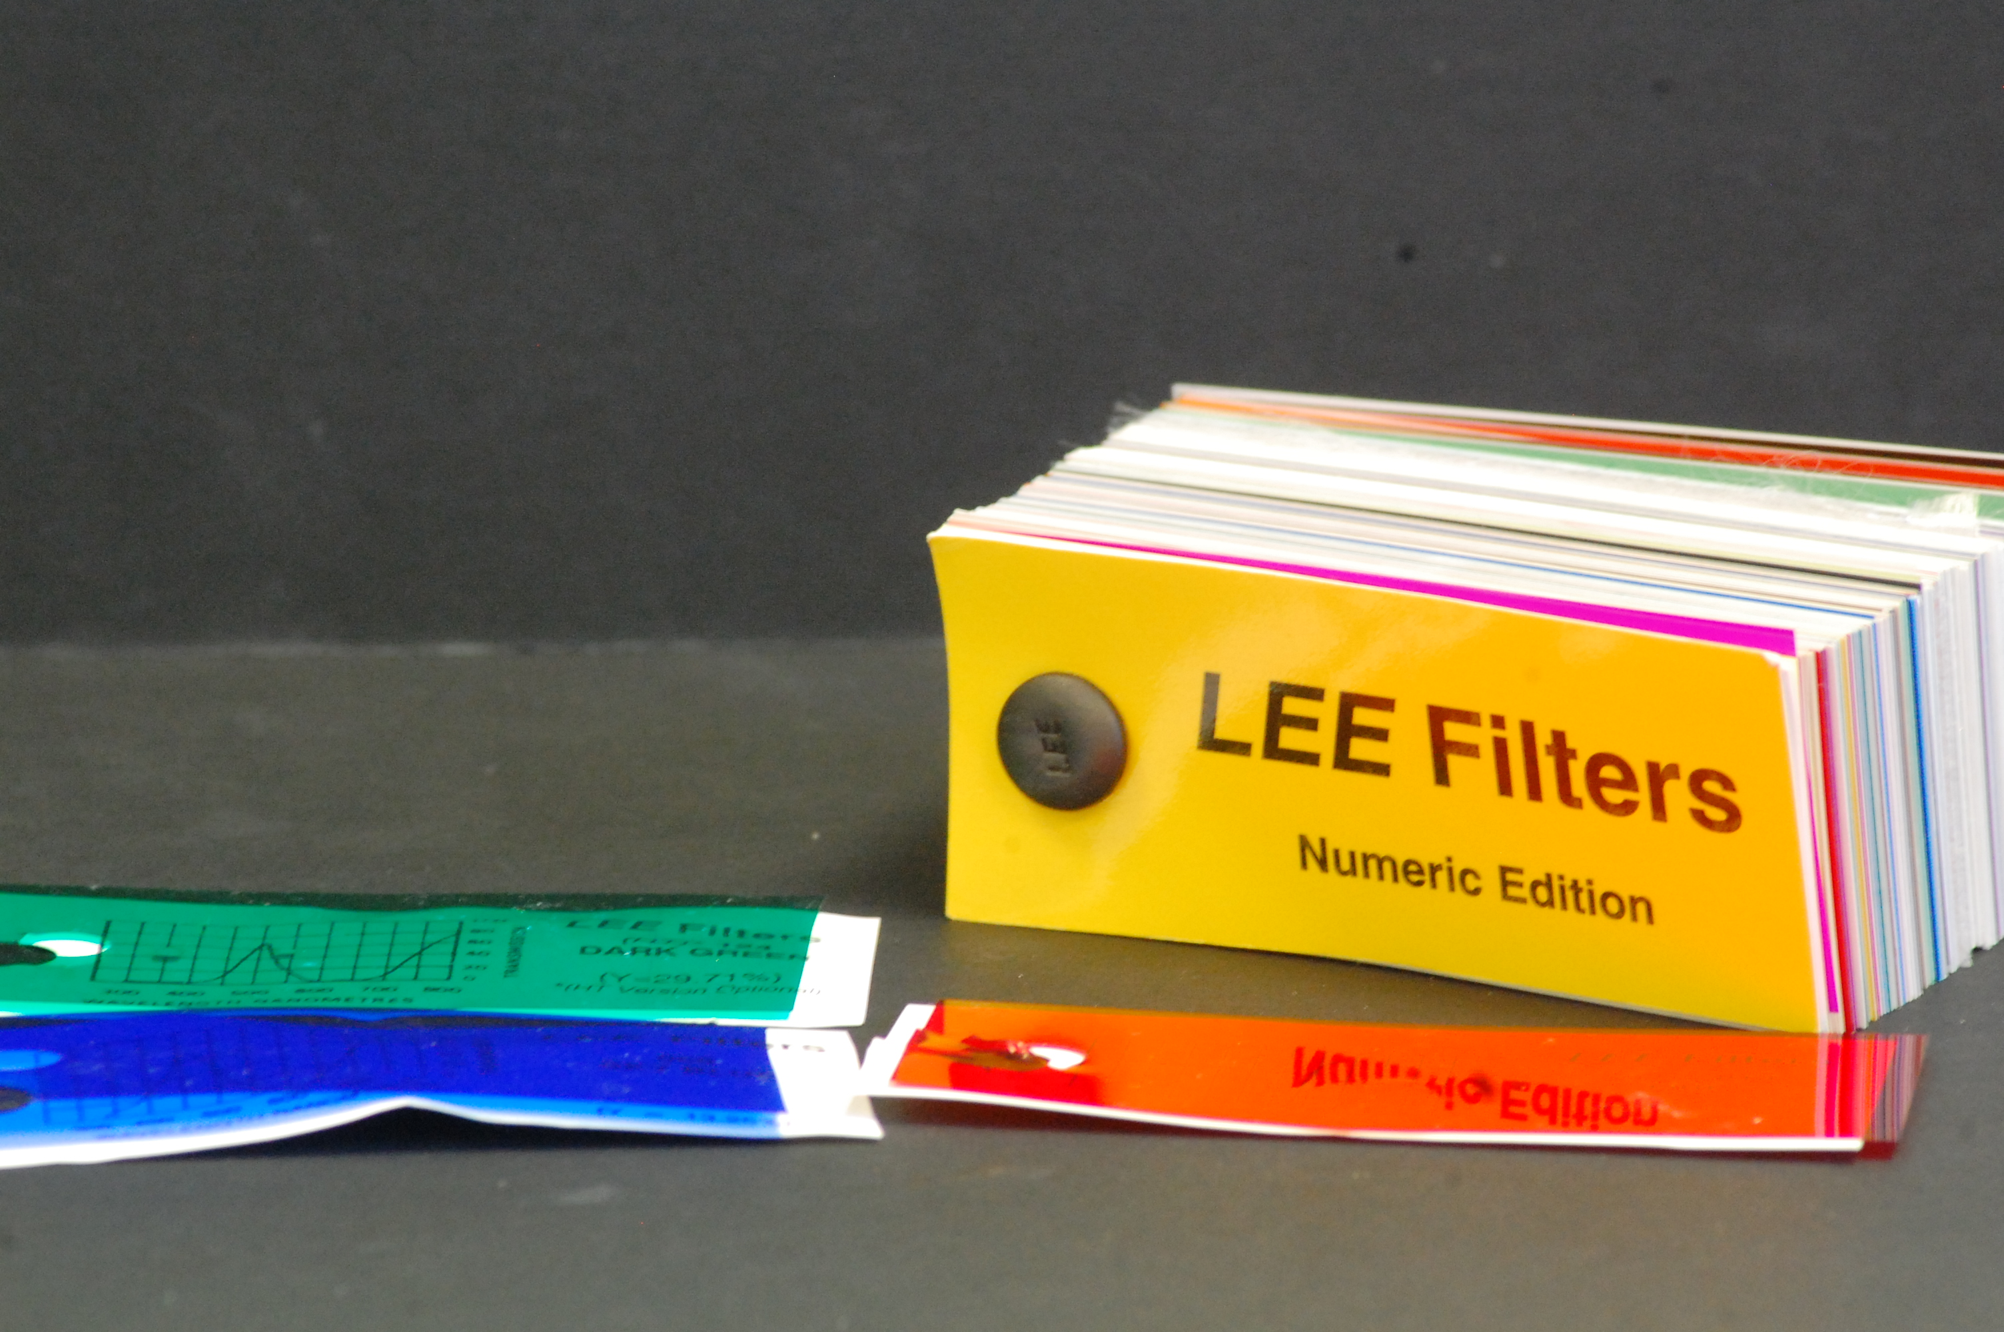
Filters
Many experiments do not need filters – the ones we are going to do today for instance
Theatrical lighting gels are a good source of colour filters – you can get free sample packs!

Slide 12
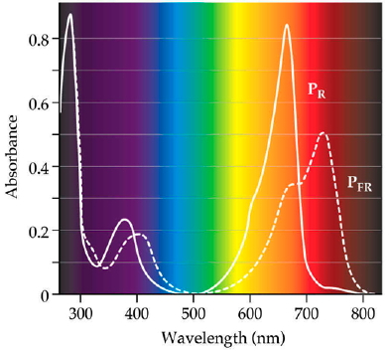
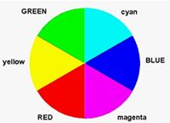
Choosing Filters
The hard way – look at the absorption spectrum and pick the wavelength that has the highest value
The easy way – use a colour wheel. Look at the colour of your solution and pick a filter of the colour on the opposite side.

Slide 13
Improving the results
This is a very simple set-up.
It benefits from tweaking the results.

Slide 14
Improving the results
Excel is very useful for this.
Zero them – so the lowest value becomes zero

Slide 15
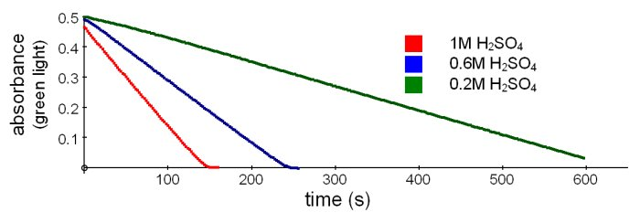
Improving the results
2. Express them as a percentage.

