Slide 1
Let’s Talk - Bogs

Slide 2
Experiences and Outcomes
I can explore examples of food chains and show an appreciation of how animals and plants depend on each other for food [SCN 1-02a]
I can use my knowledge of the interactions and energy flow between plants and animals in ecosystems, food chains and webs. I have contributed to the design or conservation of a wildlife area. SCN 2-02a
Through carrying out practical activities and investigations, I can show how plants have benefitted society [SCN 2-02b]
I can report and comment on current scientific news items to develop my knowledge and understanding of topical science.
SCN [2-20b]

Slide 3
Experiences and Outcomes
Lit 1-02a, Lit 2-02a, Lit 1-09a,
Lit 2-09a
MNU 1-03a, MNU 2-03a, MNU 2-11b,

Slide 4
Principles and Practice
develop a curiosity and understanding of their environment and their place in the living, material and physical world
develop skills of scientific inquiry and investigation using practical techniques
develop skills in the accurate use of scientific language, formulae and equations
express opinions and make decisions on social, moral, ethical, economic and environmental issues based upon sound understanding
Benchmarks
Inquiry and investigative skills

Slide 5
What is peat?
It is composed mainly of wetland vegetation: principally bog plants including mosses, sedges, and shrubs
Peat forms when plant material does not fully decay in acidic and anaerobic conditions
This process takes a long time: it take a year for 1mm of peat to form
Notes:
10m deep peat will have taken 9000 years to form

Slide 6
Why are bogs important?
They act as a carbon store
They act as a water store
Sphagnum moss is an
important plant in bogs
Holds up to 20 times its weight in water
Notes:
https://bogology.org/2013/09/27/sphagnum-moss-bog-plant-extraordinaire/
“Sphagnum has a very interesting physiology – not only can it hold around 20 times its own weight in water, effectively acting as a sponge, but it actively engineers an environment in which it flourishes whilst making conditions difficult for other plants to outcompete it. Clever, eh?! It does this through a process called cation exchange – by taking up nutrients such as potassium and magnesium and giving up hydrogen ions in exchange – a process that effectively acidifies the ecosystem.”

Slide 7
What does this mean?
What other materials hold this amount of water?
Which materials are absorbent?

Slide 8
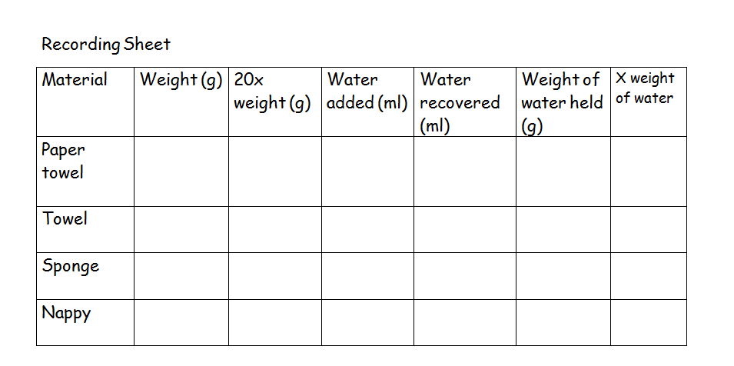
Practical Activity

Slide 9
How a bog is formed?
A bog is formed when a lake slowly fills with plant debris. Sphagnum moss, as well as other plants, grow out from the lake's edge. The vegetation eventually covers the lake's entire surface. Bogs can also form when the sphagnum moss covers dry land and prevents precipitation from evaporating
http://www.snh.gov.uk/about-scotlands-nature/habitats-and-ecosystems/mountains-heaths-and-bogs/peat-bogs/
Peat forms when plant material, usually in wet areas, is inhibited from decaying fully by acidic and anaerobic conditions. It is composed mainly of wetland vegetation: principally bog plants including mosses, sedges, and shrubs

Slide 10
About
Sphagnum mosses are the amazingly multi-coloured living carpets of moss found in wet places like peat bogs, marshland, heath and moorland. When seen up close, they are very beautiful, but they also play a very important role in the creation of peat bogs: they hold water in their spongy forms long after the surrounding soil has dried out. In this way, they provide essential nutrients to the soil and help to prevent the decay of dead plant material which gets compressed over hundreds of years to form peat.
How to identify
There are at least ten species of Sphagnum moss in the UK, some of which are very difficult to tell apart. These species range in colour from red and pink, to orange and green. Sphagnum moss plants are very small, but they grow together in close proximity forming spongy carpets; 'hummocks' are even created when the mosses grow together to form large mounds up to a metre high
http://www.wildlifetrusts.org/species/sphagnum-moss

Slide 11
Let’s Talk - bogs
You have 10 statements relating to your picture.
Award an importance mark to the statements. 5 is the highest mark meaning “very important.”
You only have 35 points to give out.
Write the points on the statements and arrange in order of importance.
Compare your “result” with the other groups.
Another option:
Diamond 9 (but you have 10 statements)
Arrange in order of importance

Slide 12
Additional information
http://www.snh.gov.uk/about-scotlands-nature/habitats-and-ecosystems/mountains-heaths-and-bogs/peat-bogs/
http://www.wildlifetrusts.org/species/sphagnum-moss
http://www.moorsforthefuture.org.uk/news/innovative-reintroduction-sphagnum-mosses-vital-restoration-upland-peatbogs
http://www.moorsforthefuture.org.uk/factsheets
https://bogology.org/2013/09/27/sphagnum-moss-bog-plant-extraordinaire/

