Slide 1

Discussion Activities
Vaccines and Vaccination
Kate Andrews
Marjorie Smith
June 2020

Slide 2

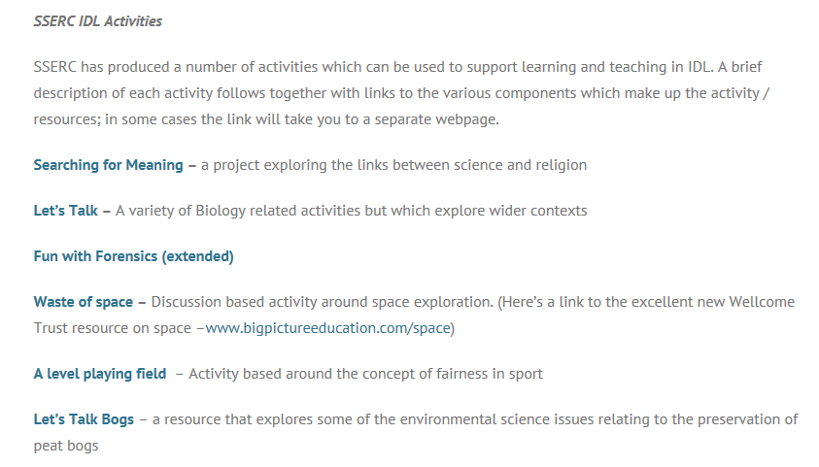

Slide 3
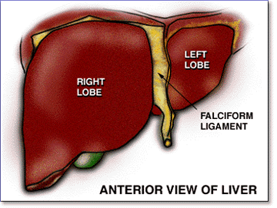
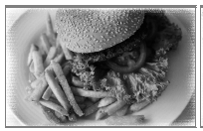
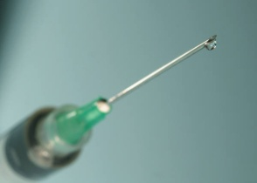

Science and Health and Wellbeing
To develop, using novel learning and teaching strategies,
three science activities, which will help teachers to raise
science-related health issues with their pupils
  The Liver and Alcohol
  Diet, Diabetes and Obesity
  Vaccines and Vaccination

Slide 4
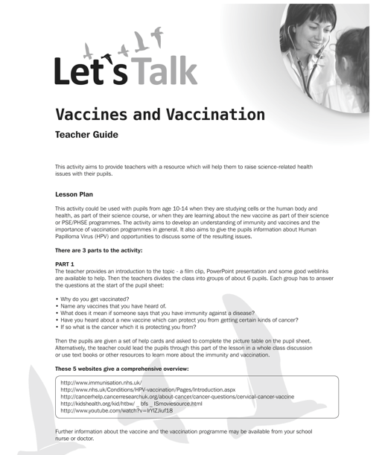

Slide 5
Surprise Attack
B. You’ve never had her vaccinated have you?
C. No never. I’ve always been meaning to.
Mr Lees you’re home on leave from the East, aren’t you?
D. That’s right. Been back nearly three weeks.
Did you bring anything with you? Apart from your normal equipment I mean?
D. One or two odds and ends for the wife…. Let’s see ….. dress material, a couple of necklaces. I picked up a rag doll for Pat.
Where? In a market?
D. Yes. But can a thing carry infection?
Oh yes, it’s quite possible
C. If only I’d had her vaccinated
A. Now, now Mrs Lees there’s no good crying over spilt milk ………

Slide 6
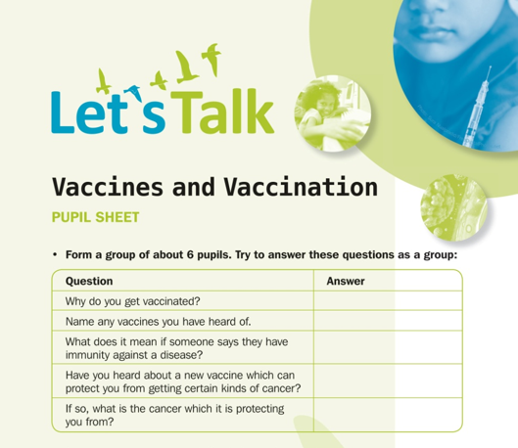

Slide 7
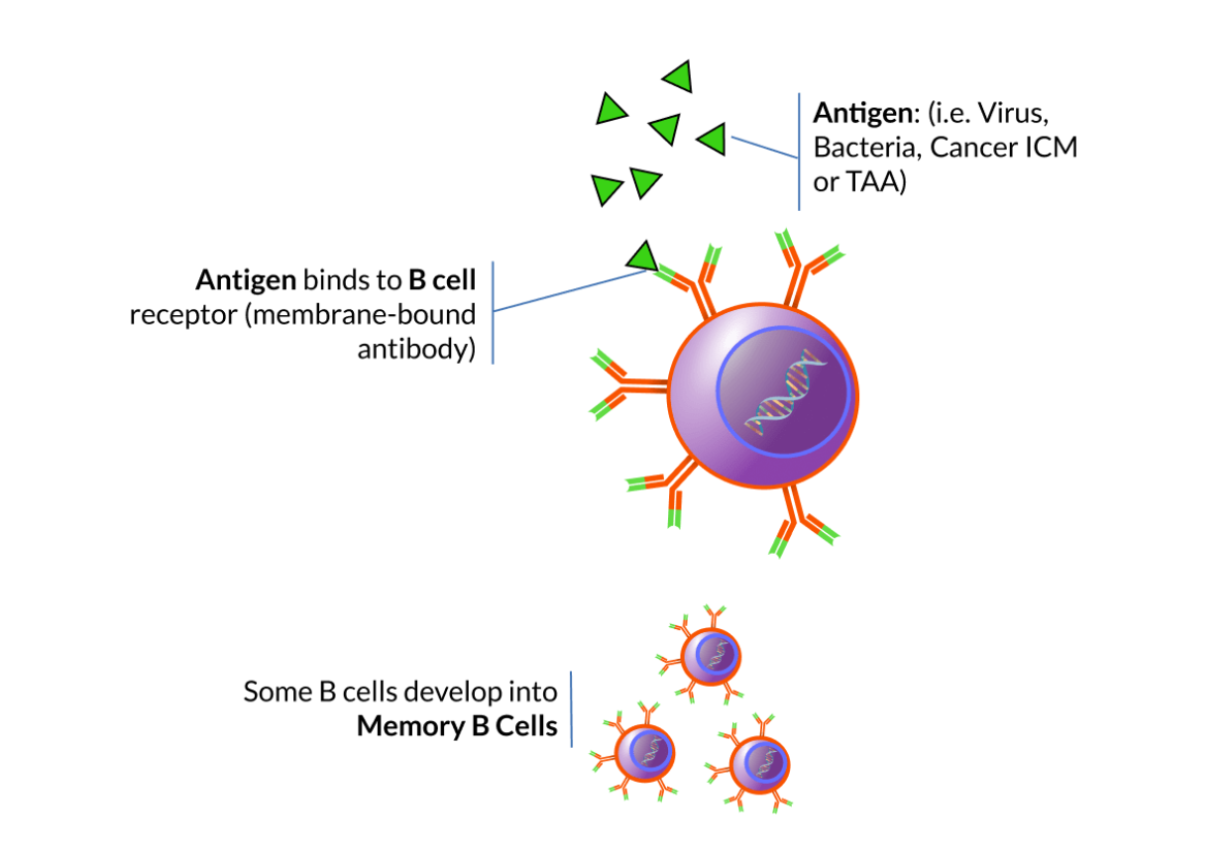

Slide 8
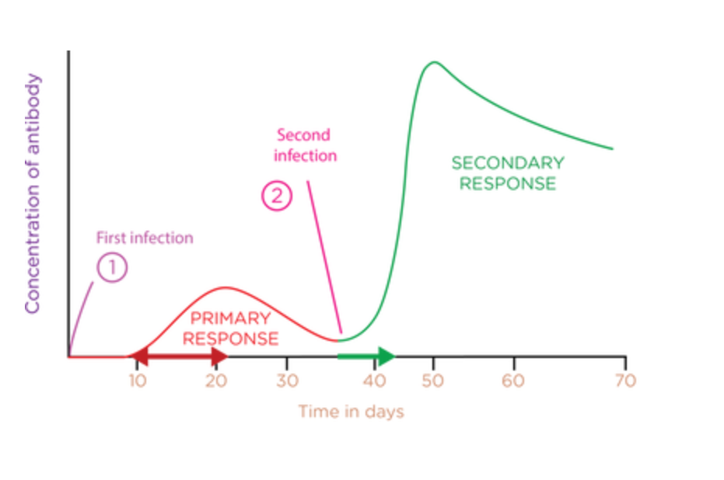

Slide 9
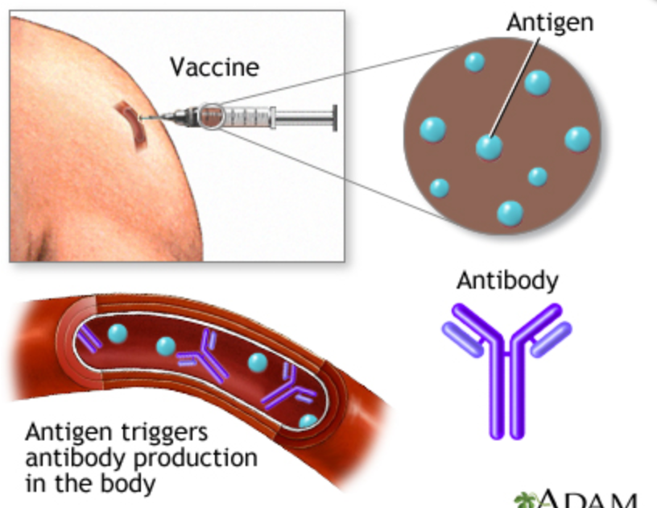

Slide 10
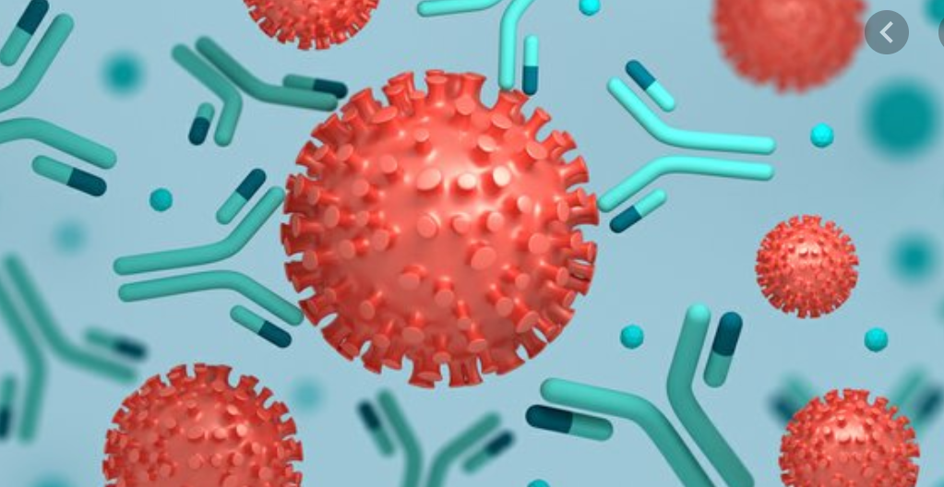
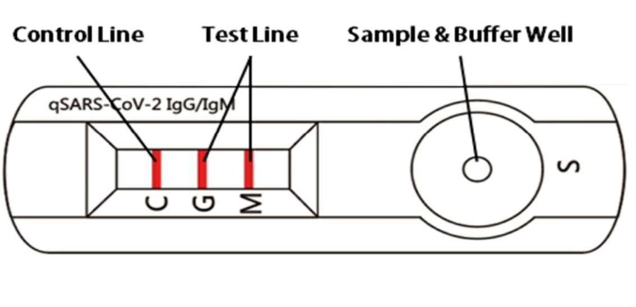

Slide 11
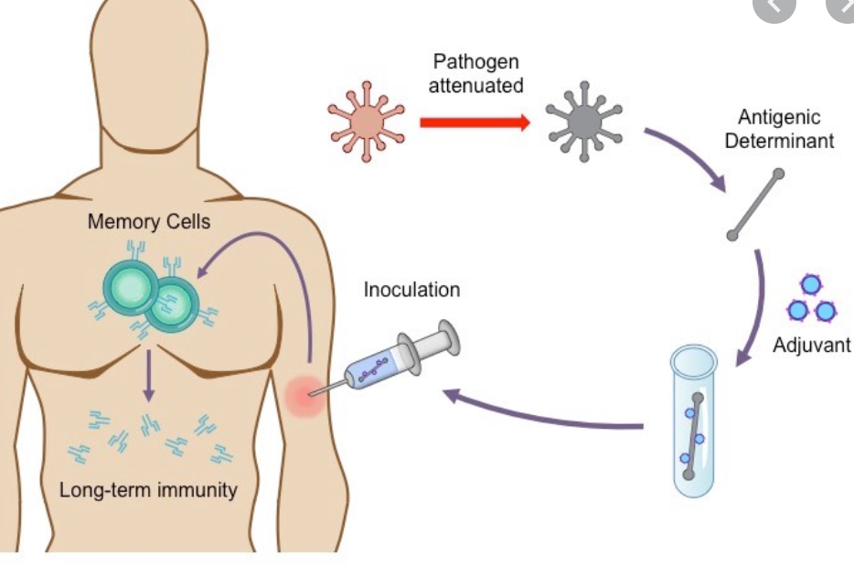

Slide 12


Slide 13
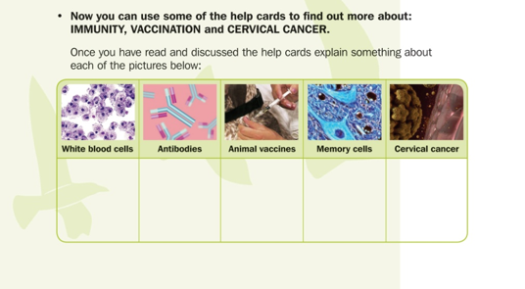

Slide 14
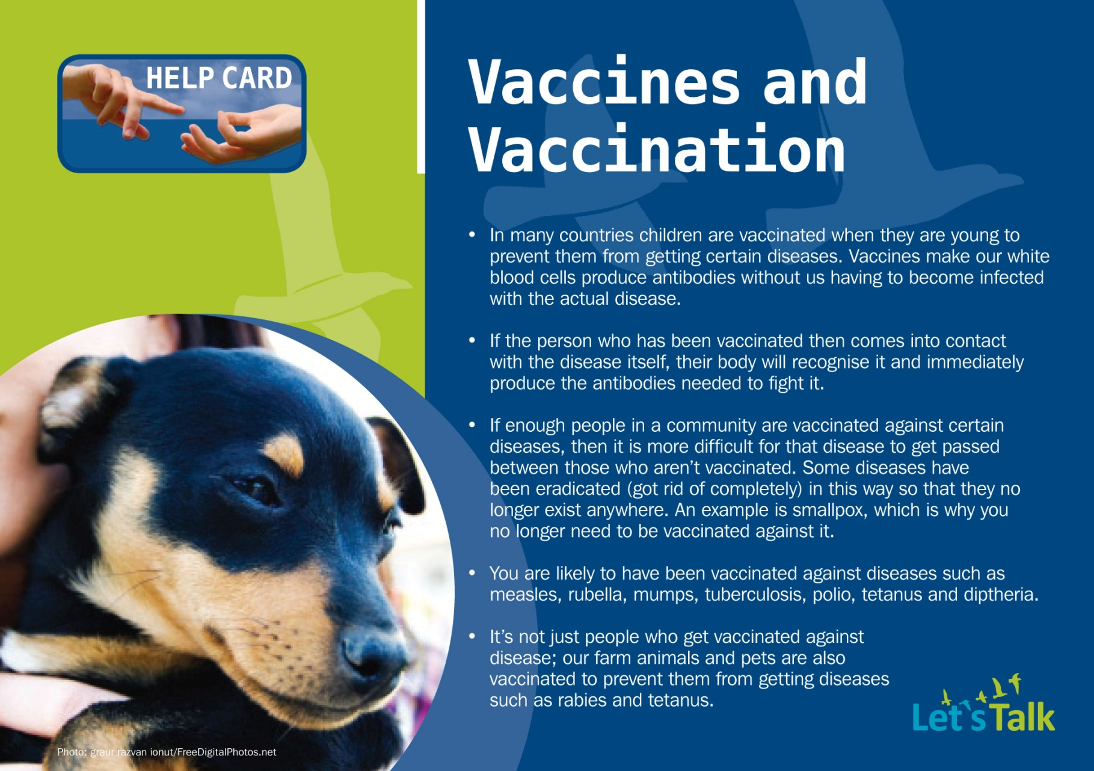
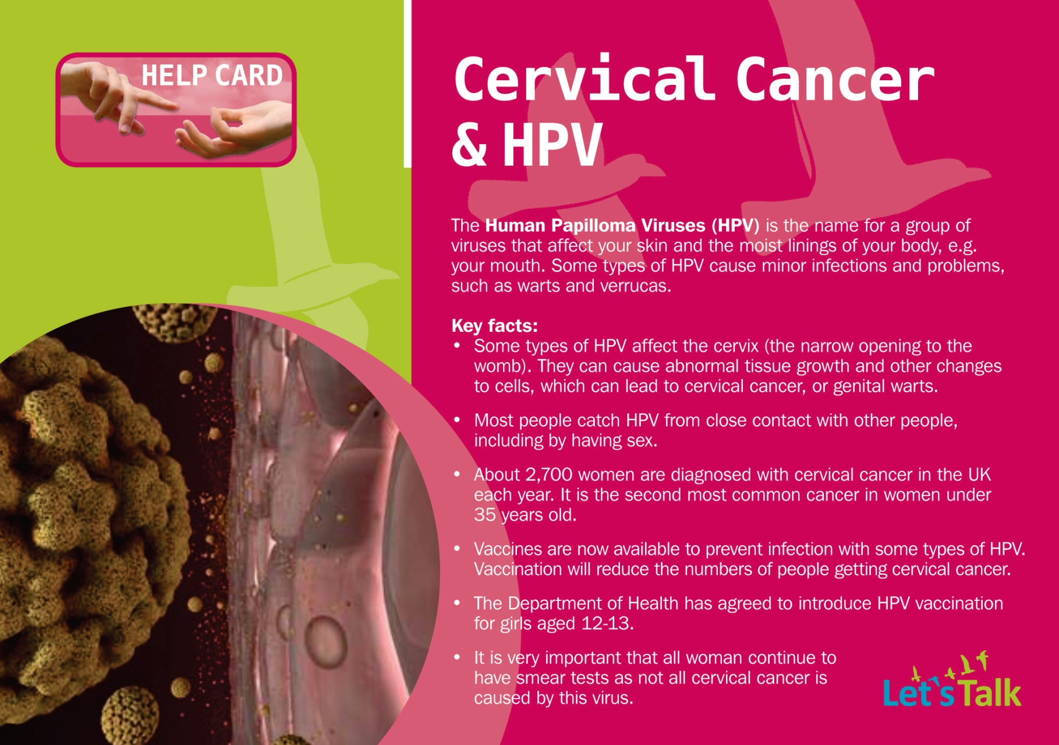
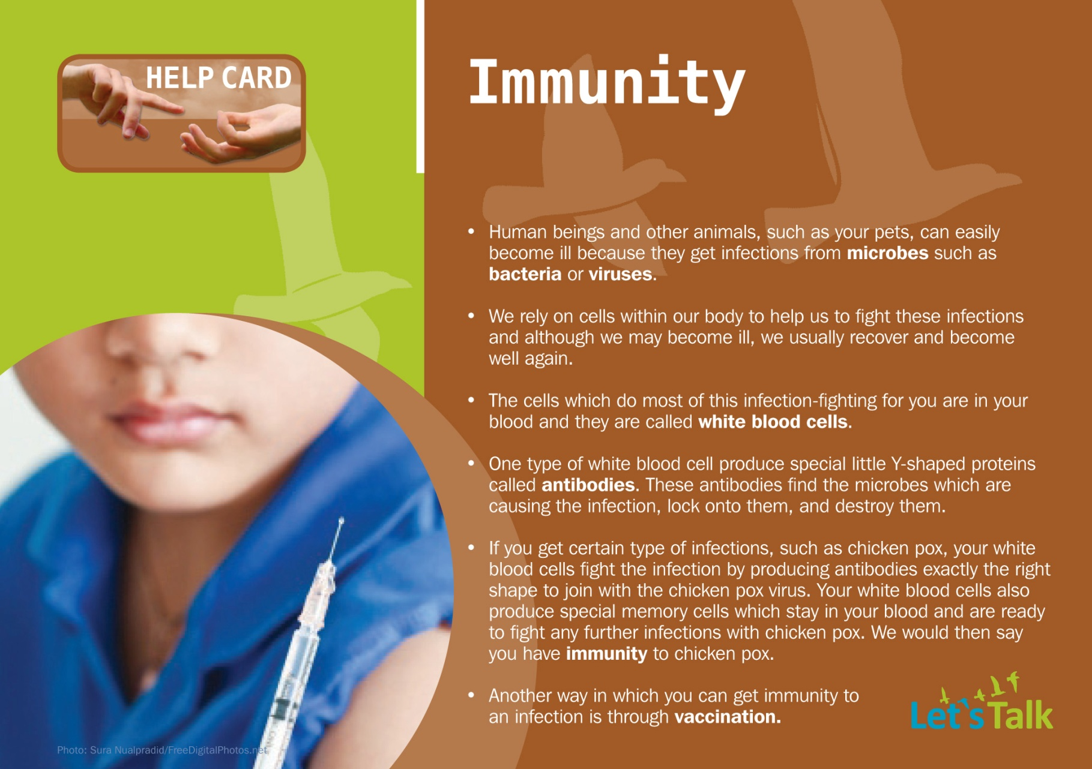

Slide 15



Slide 16
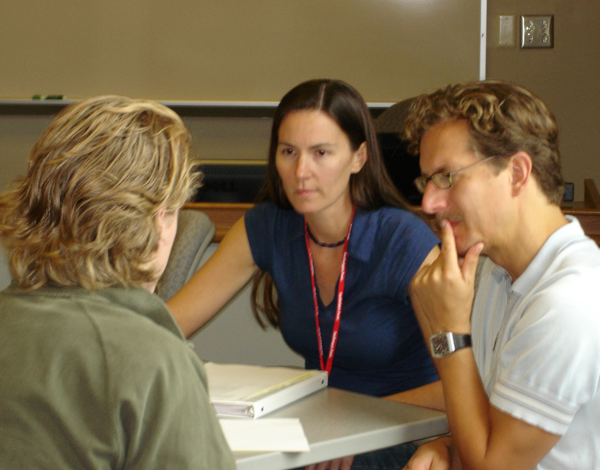
Encouraging discussion skills in science
What do you think?

