Slide 1
Separation and identification of amino acids
using paper chromatography
Kate Andrews
Lorraine Bruce

Slide 2
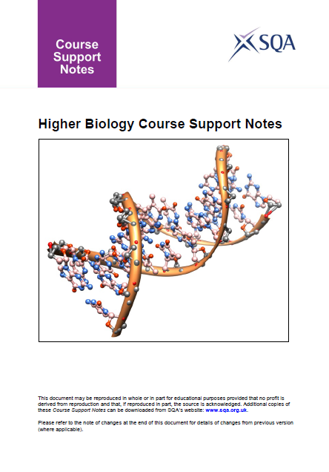
Unit 1 DNA and the Genome
3 Control of gene expression
Separation and identification of amino acids using paper chromatography.

Slide 3
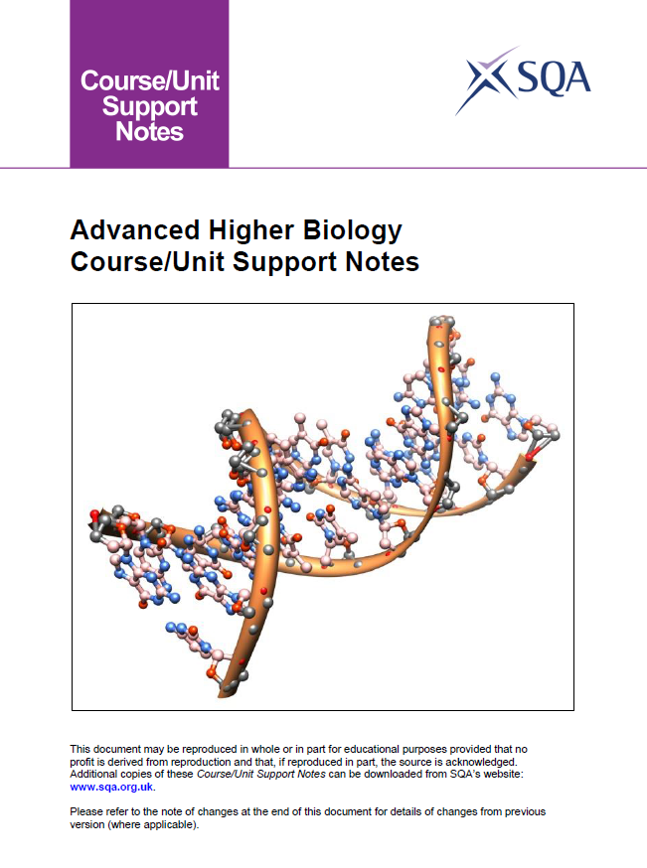
Cells and Proteins
2 Proteins
Use amino acid chromatography to distinguish between amino acids.

Slide 4
Chromatography
Separation of complex mixtures between two phases:
  a stationary phase
  a mobile phase

Slide 5
Chromatography
In paper chromatography :
the stationary phase is a uniform absorbent paper
the mobile phase is the solvent

Slide 6
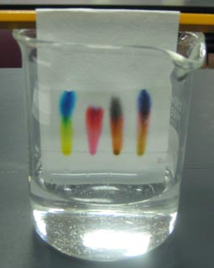
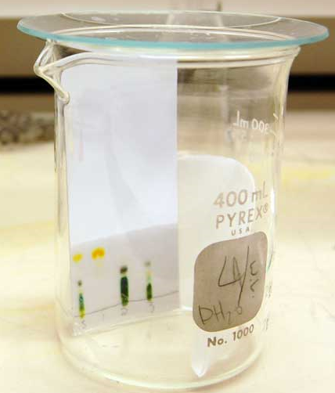
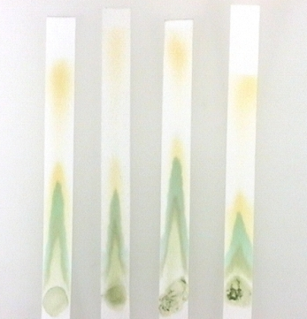
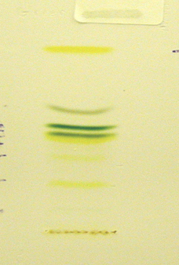

Slide 7
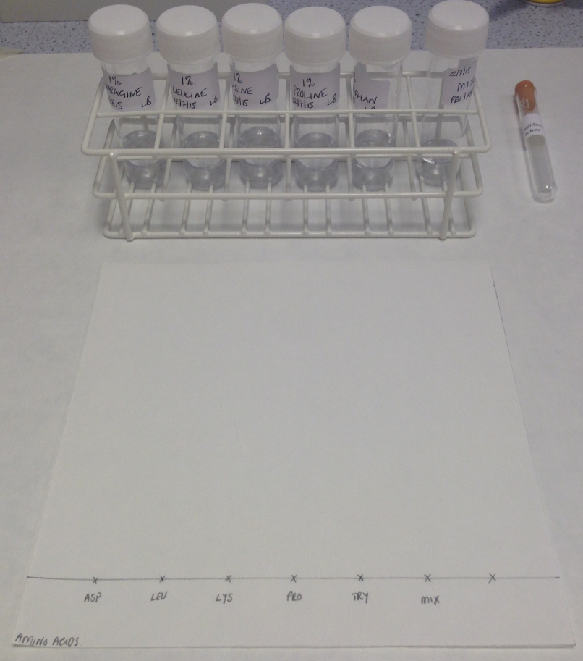
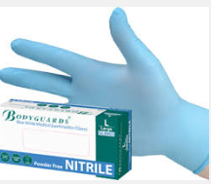
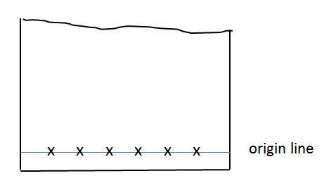


Slide 8
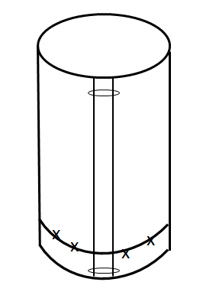

Slide 9
Safety
Solvent
ethanol - highly flammable
ammonia (.880) - corrosive, gives off toxic fumes
Prepare in fume cupboard.
Wear goggles (BS EN 166 3) and nitrile gloves
Keep ethanol and prepared solvent away from sources of ignition
Pupils wear gloves and goggles when setting up chromatogram
Keep solvent away from sources of ignition
Keep lid off solvent and chromatography tank for as short a time as possible

Slide 10
Ninhydrin – harmful if swallowed. Skin, eye and respiratory irritant. NOT a carcinogen.
Spray in fume cupboard; wear goggle and gloves
Some amino acids are irritant and harmful – those in protocol are low risk
Risk assessment
A risk assessment should be carried out by the technician preparing the chemicals and by the teacher supervising pupils carrying out this activity.

Slide 11
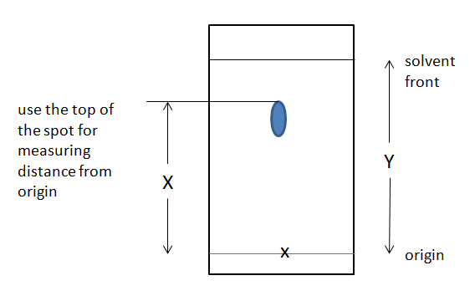
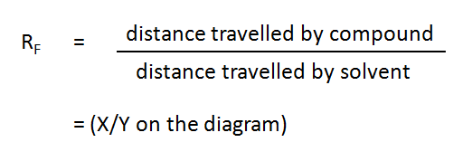

Slide 12
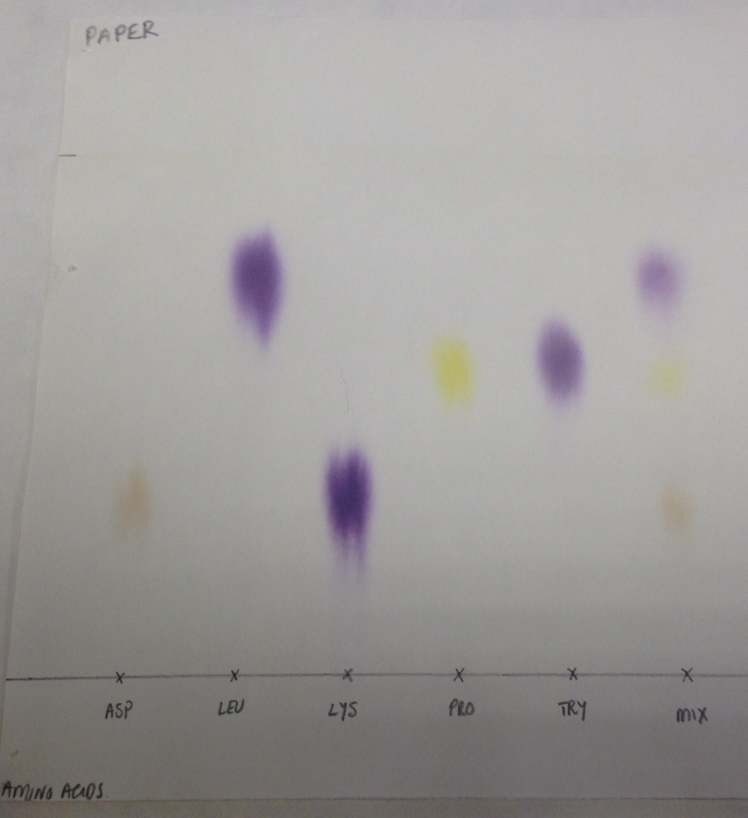

Slide 13
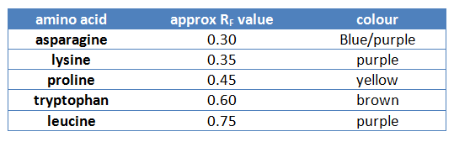

Slide 14
Paper chromatography
Separation of coloured pigments e.g. plant pigments
Separation and purification of proteins from a mixture
Pharmaceutical companies use paper chromatography to analyse
different compounds in drugs
Pathology labs use paper chromatography to detect
presence/absence of chemicals in blood
Sugars, amino acids, lipids and nucleic acids can be separated and
identified by spraying with appropriate reagents

