Slide 1
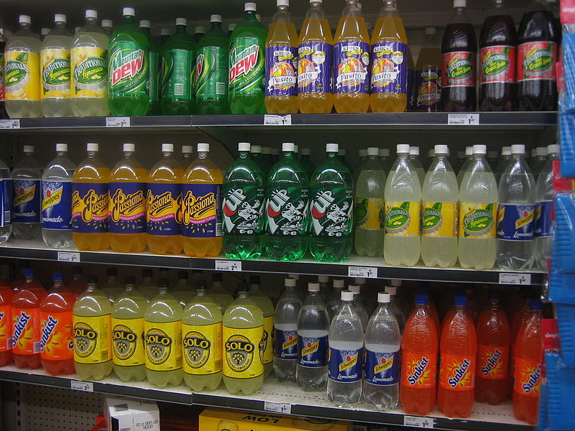

Food Forensics

Slide 2
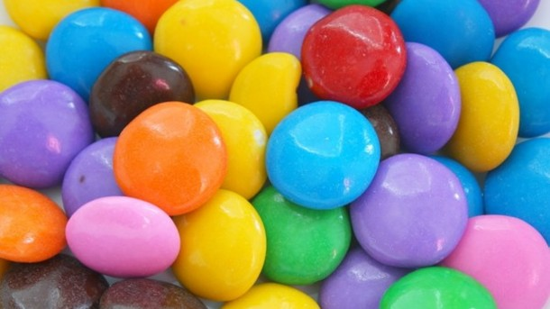
2007 Southampton six
E 102 Tartrazine,
E104 Quinoline Yellow,
E110 Sunset Yellow,
E122 Carmoisine,
E124 Ponceau 4R
E129 Allura Red
Notes:
In 2007, the Food Standards Agency published a study from Southampton University on certain food colours and their effect on children’s behaviour. The FSA Board discussed the study in the light of the review of the work by the European Food Safety Authority (EFSA) in April 2008, and agreed that the advice to Ministers and consumers should focus on the six artificial colours used in the Southampton study (E 102 Tartrazine, E104 Quinoline Yellow, E110 Sunset Yellow, E122 Carmoisine, E124 Ponceau 4R and E129 Allura Red). It agreed to advise Ministers that there should be voluntary action by UK manufacturers to remove these artificial colours by 2009, with parallel action in the EU to phase them out over a specified period.
As part of a second reading deal, the Council of Ministers and Parliament have agreed that 18 months after the new food additives Regulation comes into force, food placed on the market containing any of the six colours used in the Southampton study should carry additional label information that consumption “may have an adverse effect on activity and attention in children”.
And in response, a whole host of companies, including the U.K. branches of Tesco, ASDA, Kraft, Coca Cola and Mars (who make M&Ms), have voluntarily removed artificial colours, the preservative sodium benzoate, and aspartame from their products. Particularly those marketed to children.

Slide 3
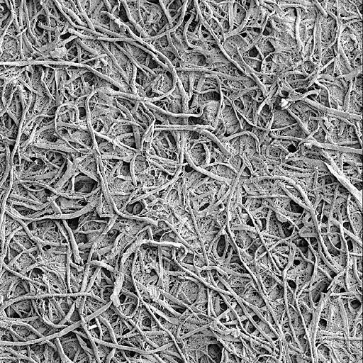

Chromatography
Stationary phase
Mobile phase

Slide 4

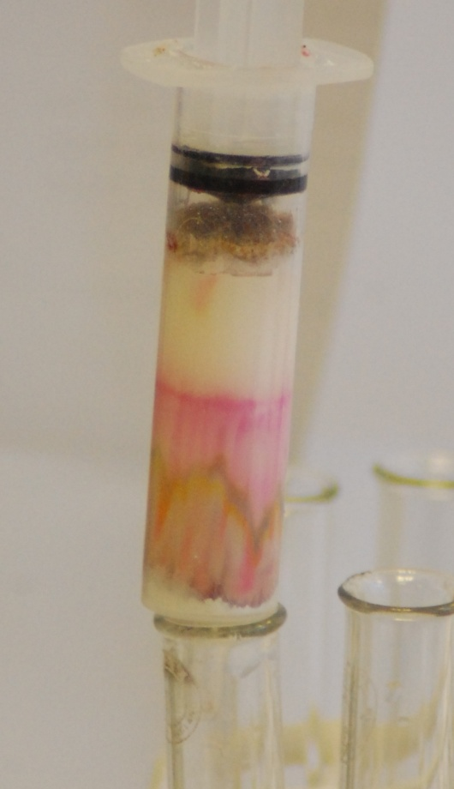
Column Chromatography

Slide 5
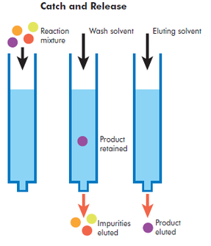
Solid Phase Extraction
Notes:
This experiment involves the use of Solid-phase extraction (SPE). a particular type of column chromatography
This is a separation process by which compounds that are dissolved or suspended in a liquid mixture are separated from other compounds in the mixture according to their physical and chemical properties.
Analytical laboratories use solid phase extraction (SPE) to concentrate and purify samples for analysis, which is what you will be doing.
This particular form of SPE uses reverse phase chromatography.
Reversed phase separations involve a polar or moderately polar mobile phase, in this case water as we are using an aqueous solution, and a nonpolar stationary phase.
The analytes of interest, in this case the colourings, are typically mid- to nonpolar.
Binding of organic compounds from polar solutions onto these SPE materials is due primarily to the attractive forces between the carbon-hydrogen bonds in the analyte and the functional groups on the silica surface. These nonpolar-nonpolar attractive forces are commonly called van der Waals forces: or dispersion forces.
Once the compound has attached to the column, we use a nonpolar solvent to disrupt the forces that bind the compound to the packing and thus elute it for analysis.

Slide 6
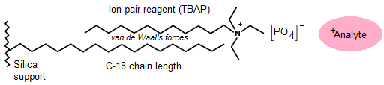
Ion Pair Chromatography
Notes:
Developed by Dr. Gordon Schill in 1973, ion pair chromatography relies upon the addition of ionic compounds to the mobile phase to promote the formation of ion pairs with charged analytes.
These reagents are comprised of an alkyl chain with an ionizable terminus.
When used with reversed-phase chromatography, ion pair reagents can be used to selectively increase the retention of charged analytes.
In this particular experiment, tetrabutylammonium bisulphate is used to increase the interactions with the dyestuffs and thus increase both the amount and specificity their extraction from the drink. The diagrams above show tetrabutylammonium phosphate. There is a variety of TBA compounds and, we would assume, any of them will work for this. SSERC has tested the phosphate, bisulphate and hydroxide.

Slide 7
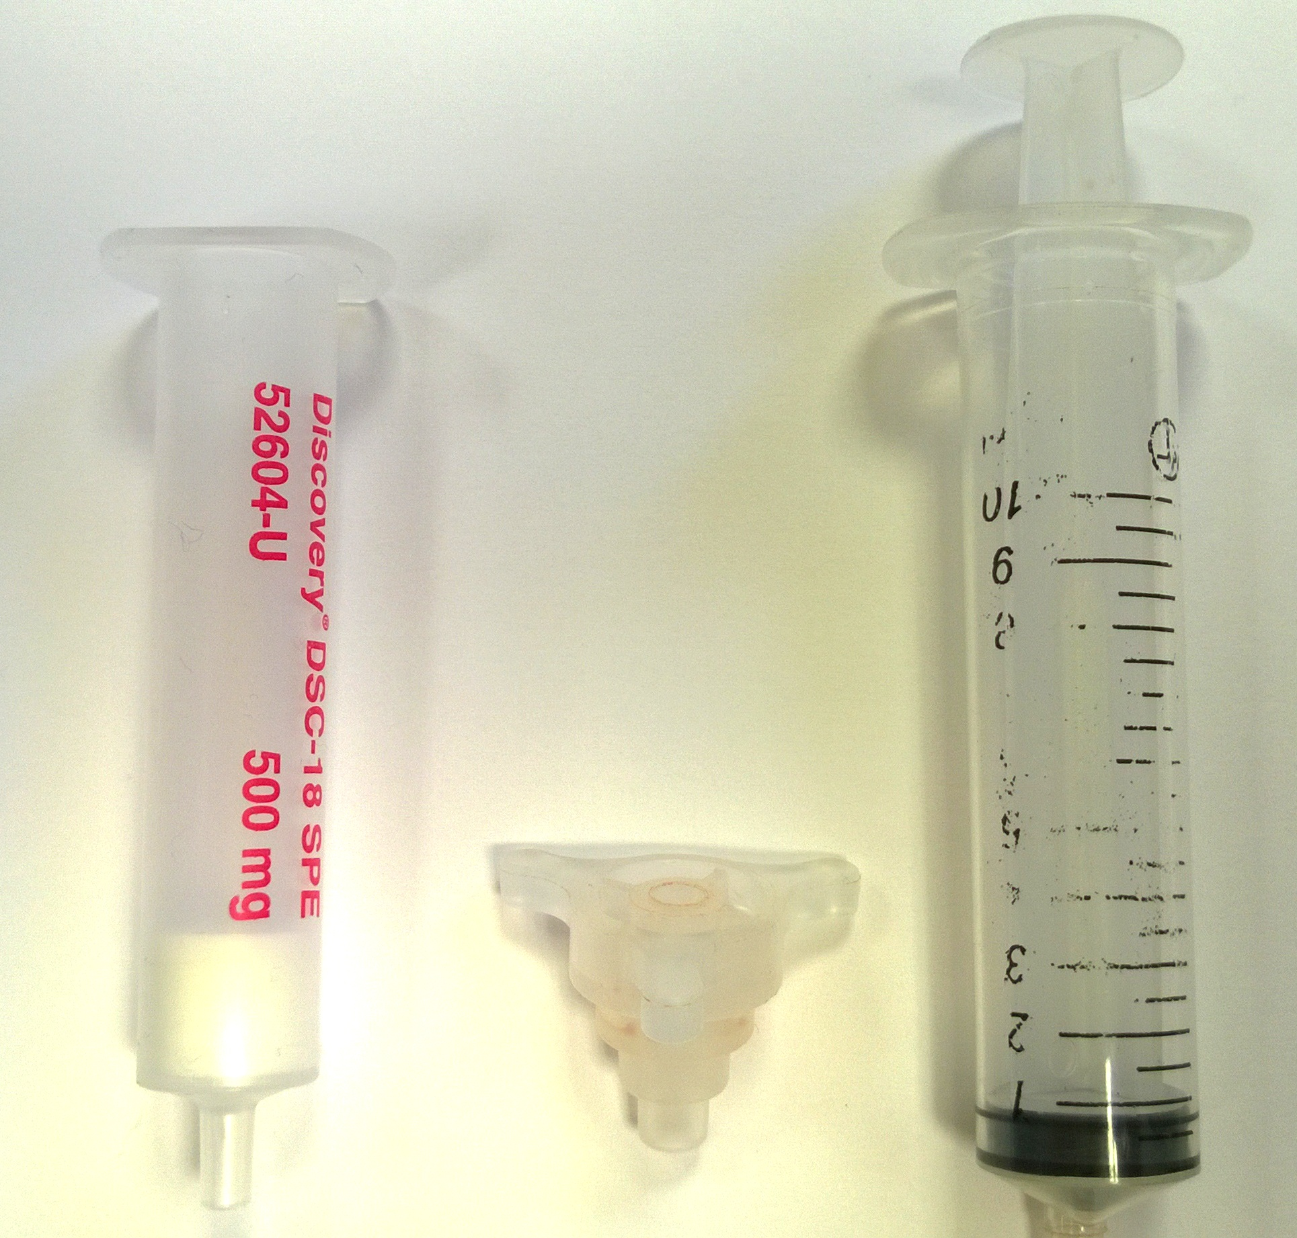

Slide 8
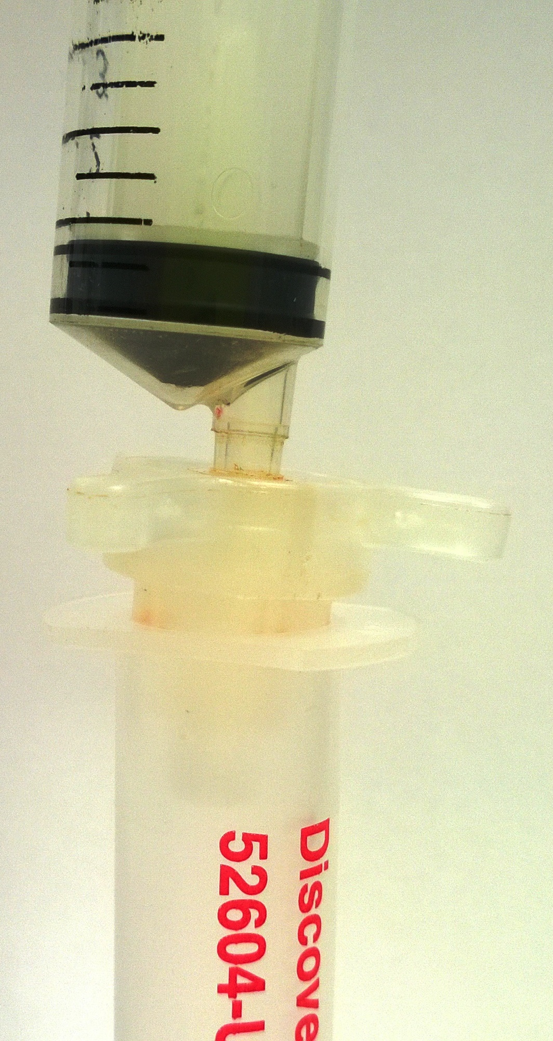
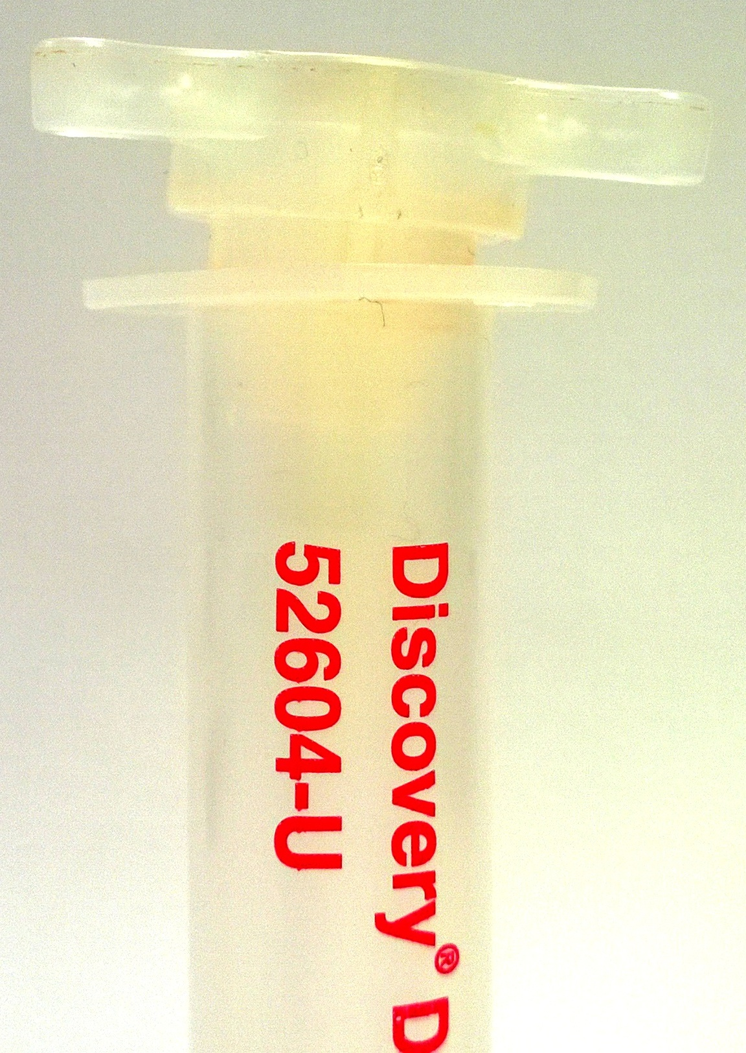

Slide 9
Don’t pull up the
plunger until you have
removed the syringe!

Slide 10
Follow the instructions to extract the colour from your two drinks.

Slide 11
Follow the instructions to analyse your colours using paper chromatography.

