Slide 1
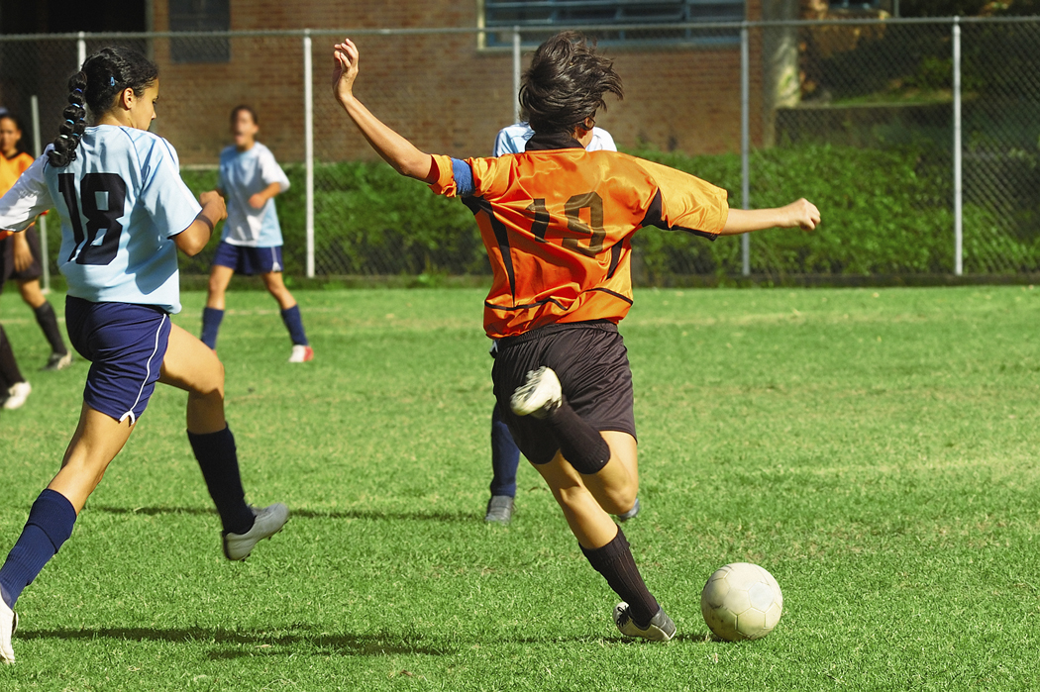
A level playing-field?

Slide 2


Slide 3
Is it fair?
Olympic athletes taking drugs to make them perform better | Some countries having more money than others to spend on training athletes
Girls and boys competing against each other in the same sports | Sports clubs only training the children they think will succeed
Able bodied and disabled athletes competing in the same competitions | Swimmers having special suits which repel water
Athletes training at high altitude to increase their oxygen capacity | The handicap system in golf
Some athletes get sponsorship and others do not | Football players earning millions of pounds
Special sports academies where all children get good training | Athletes taking asthma inhalers

Slide 4
DO THESE IDEAS MAKE SPORT FAIRER
FOR EVERYONE?

Slide 5
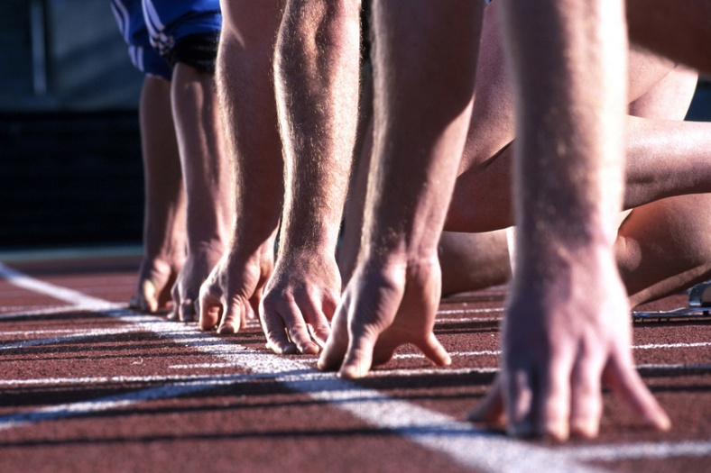
1
Races run at school
in age groups

Slide 6

2
Races run at school
in height groups

Slide 7
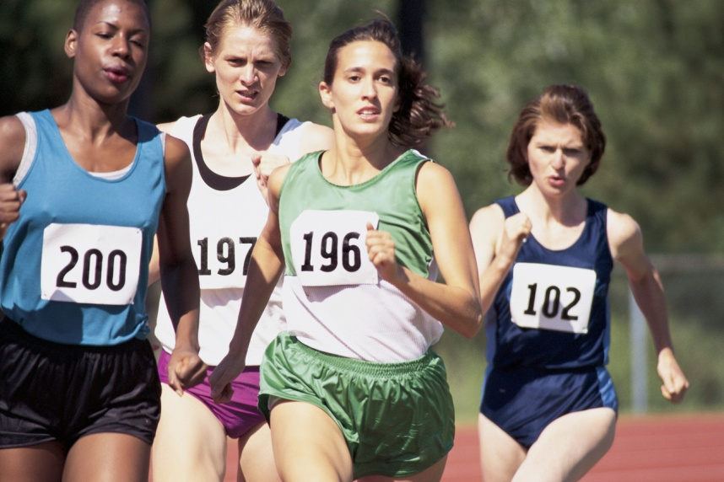
Races run at school
in the same way as
the New
Year Sprint
(everyone starts at a different place depending on their ability)
3

Slide 8
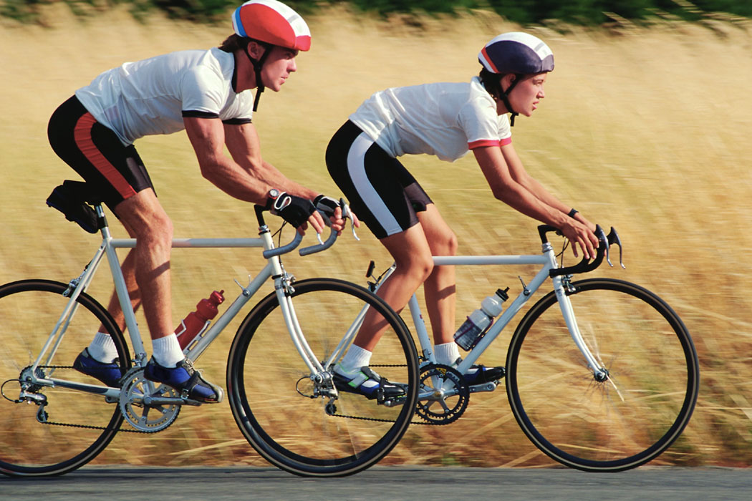
Cyclists can use
whatever bike they
like for
races
4

Slide 9
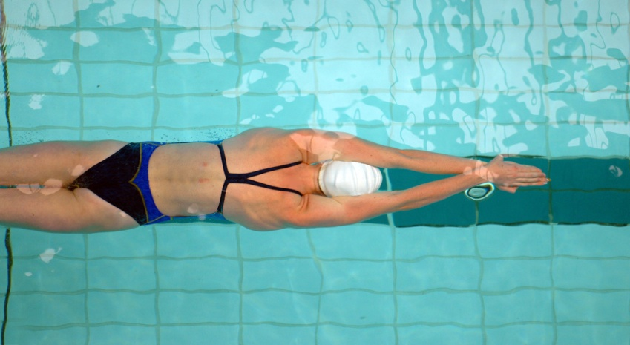
All swimmers using
the same type of
swimming costume
for races
5

Slide 10

6
Boxers being grouped
according to their
weight

Slide 11
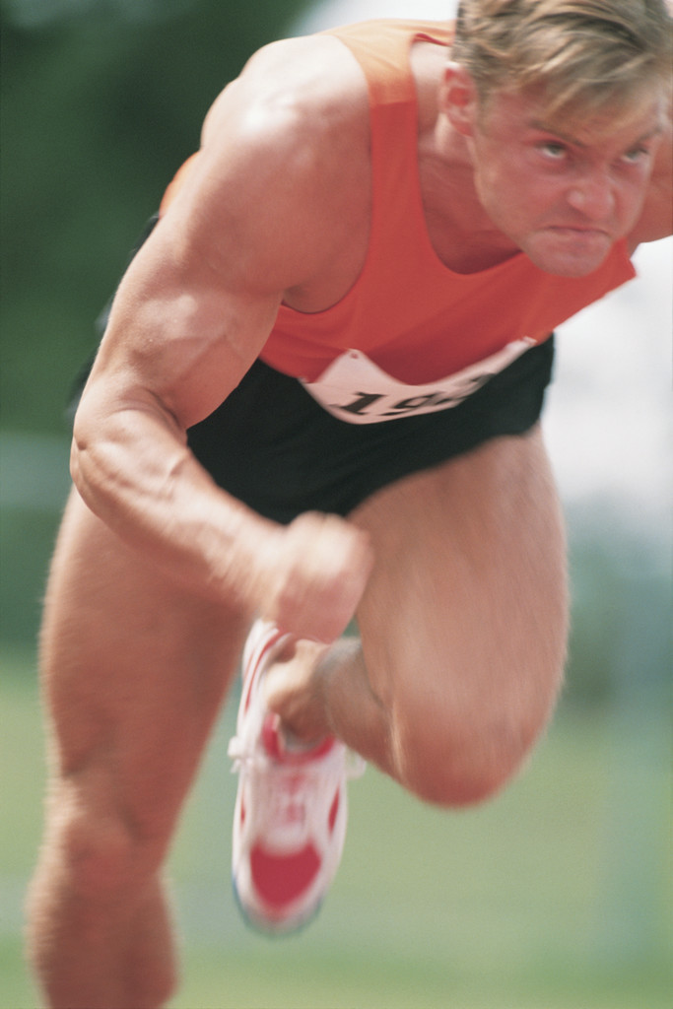
7
Drugs to make
you run faster
are allowed

Slide 12
8
Shoes to make
you run faster
are allowed

Slide 13
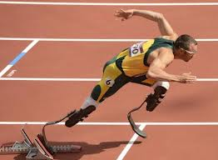
9
Blades to make
you run faster
are allowed

Slide 14
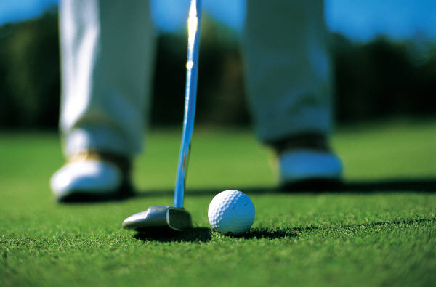
10
Golfers are given a
handicap according to
their ability

Slide 15
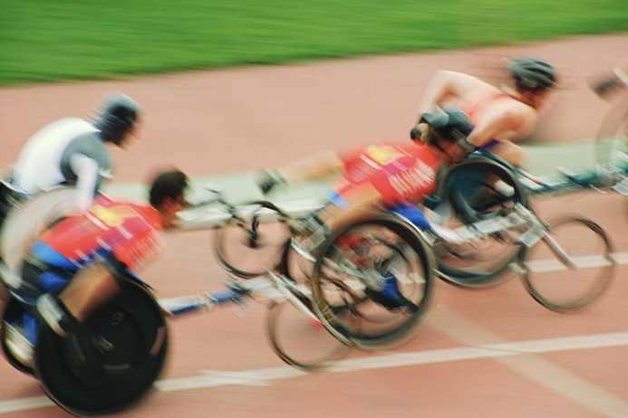
11
Disabled athletes are
matched according to
their disability

Slide 16
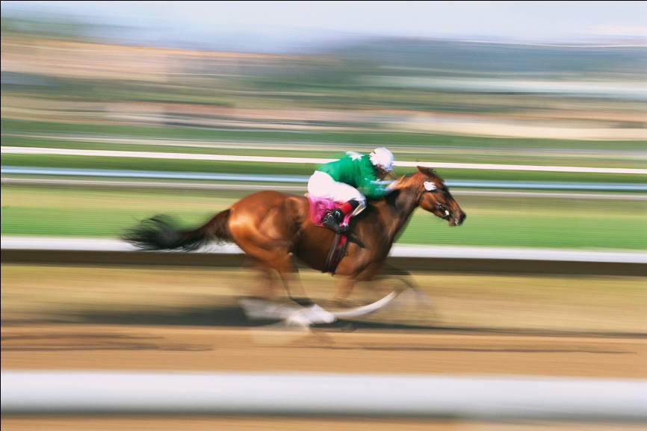
Jockeys given a weight
handicap according to
the ability of the horse
12

Slide 17
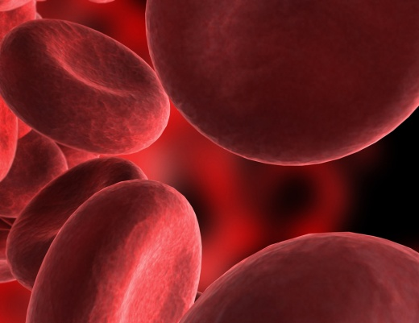
Athletes are allowed
to train at high
altitude to increase
their oxygen capacity
13

Slide 18
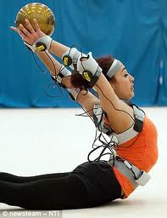
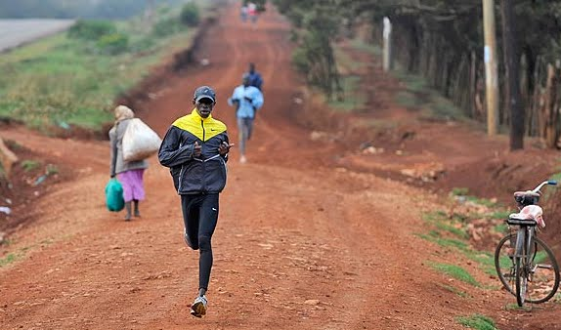
14
Athletes from different
countries have very
varied access to skilled
trainers and equipment

Slide 19
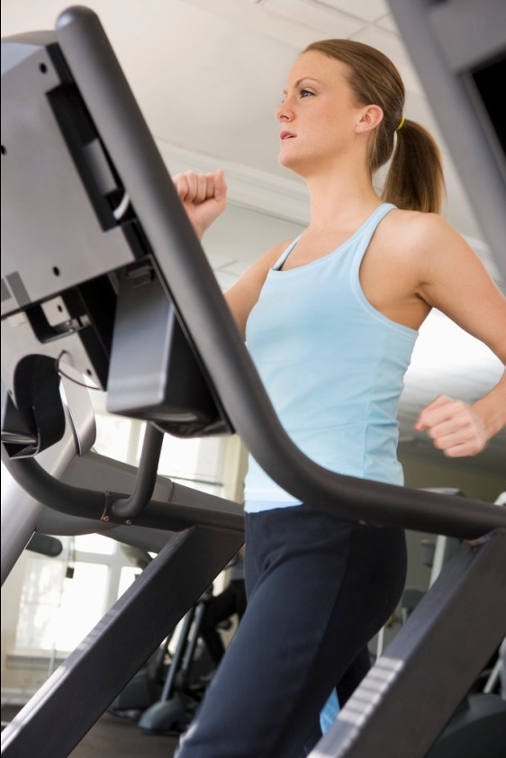
15
Some schools
become Sports
Academies and have
better training and
equipment

Slide 20
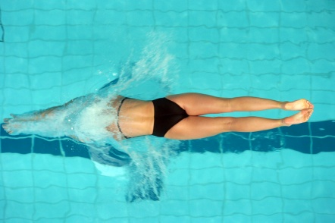

Three further examples
Superfast swim-wear
Oscar Pistorius
Gene testing to see which sports you
would be best at

