Slide 1
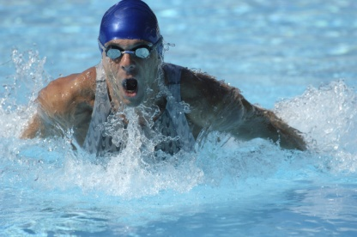
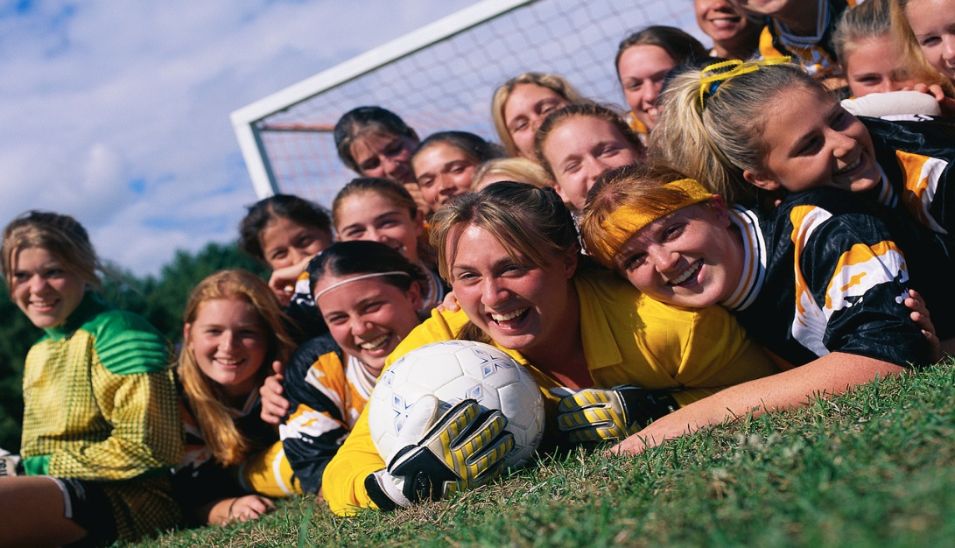
SCIENCE and SPORT

Slide 2
SPORT
WHY?

Slide 3
SPORT –Why?
Make a list of all the reasons why you think people do sport.
like winning

Slide 4
SPORT –Why?
Make a list of all the sports you have tried and which ones you like or don’t like and why?
Sport | like/dislike/ok | Why?

Slide 5
SPORT
Health

Slide 6
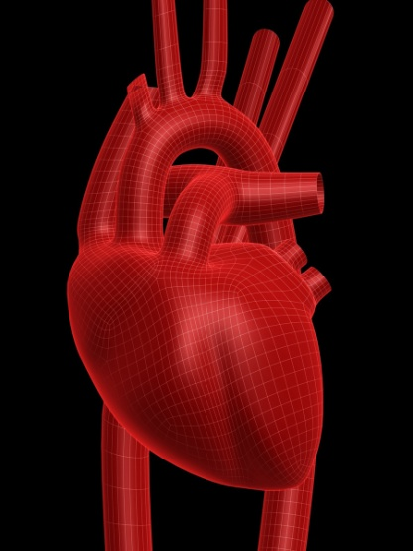
SPORT –Health
Most people think that taking part in sports is good for your health.
http://www.youtube.com/watch?v=BQdnd40AyDI
http://www.youtube.com/watch?v=PbeLZwqSrgE

Slide 7
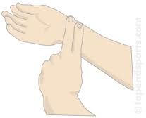
SPORT –Health
Heart beat: sit quietly for 2 minutes and then count how many times your heart beats in 1 minute. Repeat this 3 times and get an average.
heart | 1st time | 2nd time | 3rd time | average
beat

Slide 8
SPORT –Health
Heart beat: Now your teacher will tell you what exercise to do for 2 minutes. As soon as you have finished count how many times your heart beats again.
heart | 1st time | 2nd time | 3rd time | 4th time
beat

Slide 9
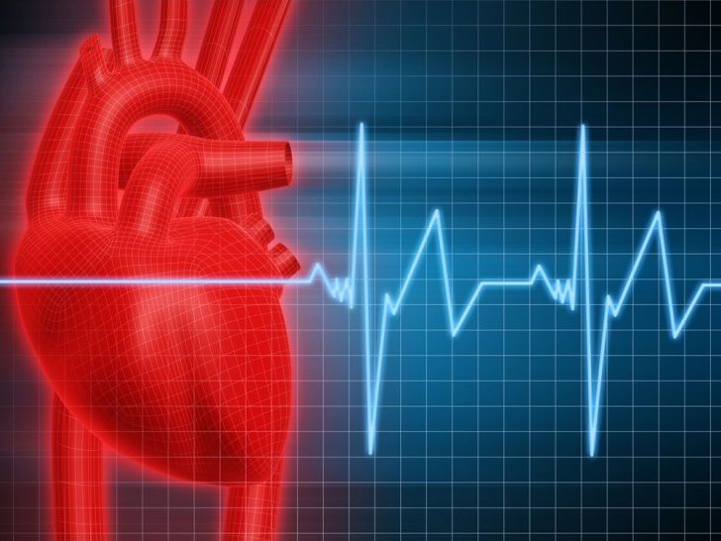
SPORT –Health
Heart beat: Your heart beat probably got faster when you exercised. It then goes back to your normal average which you measured the first time.
If it goes back to normal
quickly this usually
means you are fit.

Slide 10
SPORT
Fair play

Slide 11
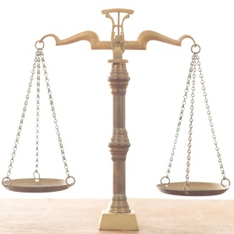
SPORT –fair play
There might be some things about a sport which you think make playing it unfair.
You might think of ways to make it fair.
Example of something unfair | How to make it fair
We are going to talk about this in more detail soon

